Slide 1
UN training package: on ‘Analysis’ we will cover 5 topics
Defining/Refining the Problem
Understanding Power
Analysing the Context
Mapping the Stakeholders
The Bridge to Strategy

Slide 2
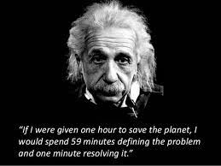
1. Defining the Problem

Slide 3
When thinking about the problem, where you start will probably not be where you finish
Notes:
End video at 2m36s, after ‘manifestation of the problem’

Slide 4
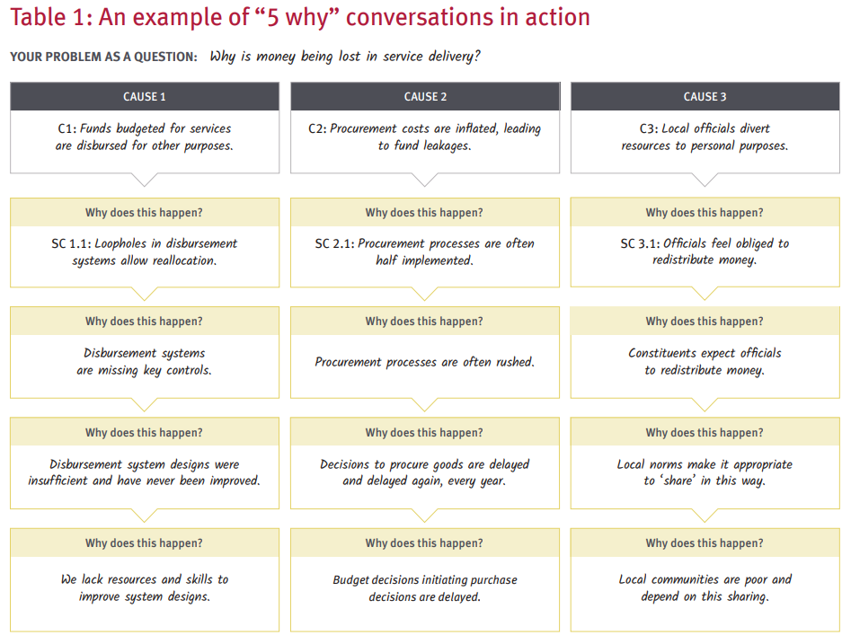
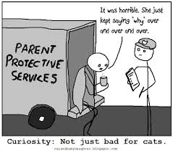
Example of the 5Ys in Action

Slide 5
Top Tips on Defining the Problem
Don’t do this alone – who might have additional insights (eg people affected by the problem and/or colleagues from other institutions)?
Convert the problem into a Question and apply the 5Ys (‘why does this happen?’)
Don’t be satisfied with generic problems like ‘lack of political will/leadership’ or ‘corruption’ – keep digging
Stop when you are satisfied that you have a clear, manageable problem with a likely point(s) of entry for influencing

Slide 6
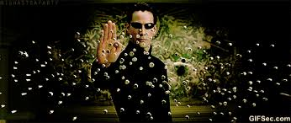
Understanding Power
Notes:
A common conception of power is control over others or the ability to carry out one’s will. However, power is subtler. For example, there are different expressions of power:
Power is like the Matrix – a force field that permeates society, politics and the economy drives/shapes social change (or the lack of it). Making power ‘visible’ is a good first step in designing better influencing strategies.
To do that, we need to be able to recognize different kinds of power, and have tools to explore them

Slide 7
Practitioner Frameworks for Understanding Power
Visible/Hidden/Invisible (descriptive – context analysis)
Power Cube (scoping, especially from local ↔ global)
Rao and Kelleher (scoping, especially on gender/social exclusion)
4 Powers (planning/action – for your strategy)

Slide 8
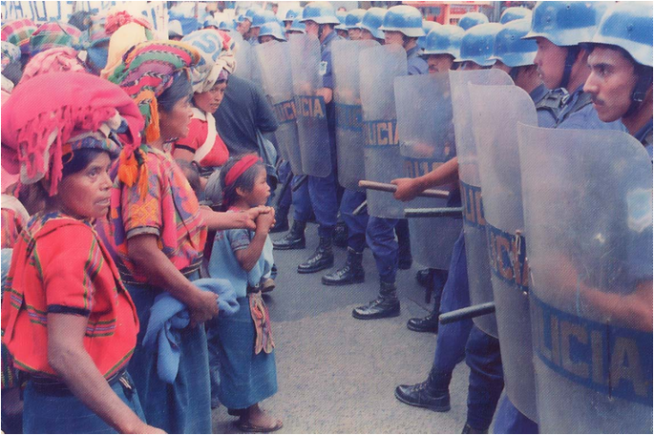
Visible, Hidden and Invisible
Notes:
What kinds of power are involved in this photo from Guatemala?
• Visible power is when decision making is observable and leads to formal and recognizable rules, laws, structures and procedures. In this scenario, power is in the public realm.
• Invisible power is made up of the norms, values, attitudes, beliefs and ideology that shape a person’s way of thinking. For example, despite being illegal in some African countries, the practice of female genital mutilation is still widespread. Laws arising from the formal arena of power that prohibit such practice have not been successful in eliminating it. Such laws are not enforced because powerful groups do not see it as an important issue. Strong cultural and social norms push women to accept this practice.
• Hidden power refers to the informal shaping or influencing of the political agenda from behind the scenes. It is often without legitimacy, as it usually happens outside of the legal governance processes in a country.

Slide 9
The Power Cube
LEVELS
FORMS
SPACES
http://www.powercube.net/
Notes:
Some examples to think about
Local parents group campaigning for free school dinners
Peasants´ social movement occupying unproductive land and beginning to grow crops
C20 – official space for civil society within the G20
G20 People´s Forum – autonomous space protesting against the legitimacy of the G20
Policy Roundtable with government ministry and big pharma companies on access to HIV drugs
Invitation to Oxfam to speak with a beer company about their new VAWG campaign

Slide 10
Unpacking the Power Cube
Forms
Visible
Hidden, operates behind the scenes
Spaces
In closed groups
With invited parties
Levels
Global/Regional
National
Invisible, based on ideology and beliefs.
In created or claimed spaces
Local
Notes:
On Invisible power: Processes of socialisation, culture and ideology perpetuate exclusion and inequality by defining what is normal, acceptable and safe

Slide 11
Adapted from Rao and Kelleher, Gender at Work
Rao and Kelleher
Notes:
We introduced the gender and power framework – will look at this in more detail in a subsequent webinar
Looking at individual change and systematic change at the different levels and in the formal and informal spaces
With focus on in informal spaces on:
Consciousness: knowledge, skills, political consciousness and commitment to change toward equality
Cultural Norms: influences what changes are possible at individual level, some think most important
As well as access to resources and changes at the institutional level and in laws and practices
We need to understand what change is needed in all of the domains to plot our intervention and achieve sustainable change and long-term impact.

Slide 12
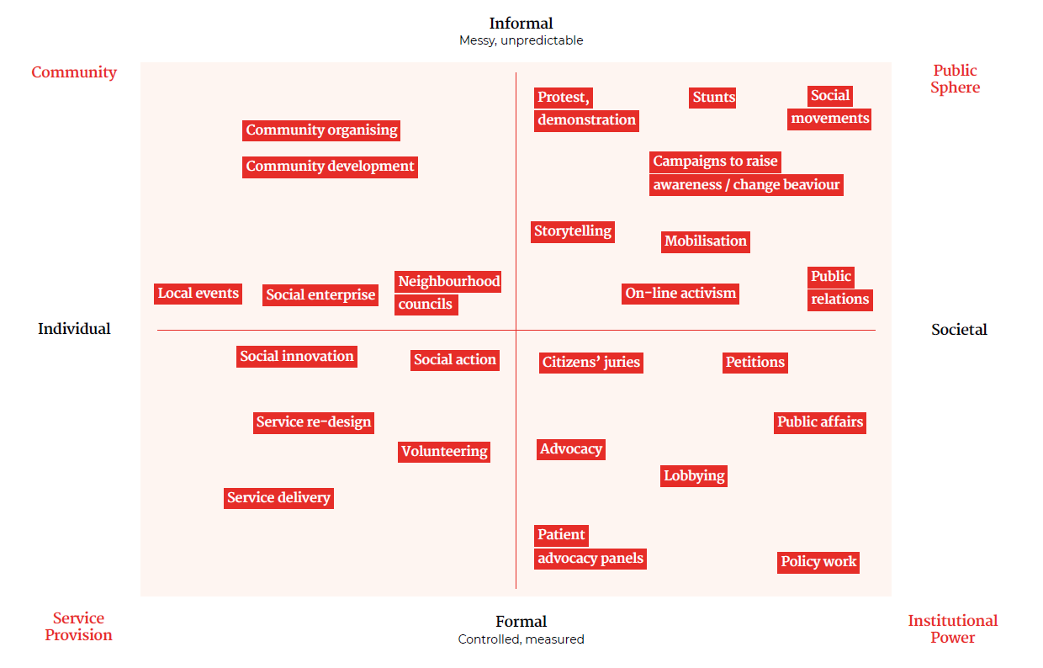
Different tactics according to quadrant (the Social Change Project)

Slide 13
4 Powers model (Rowlands 1997)
Power Within
Power With
Power To
Power Over
Notes:
• Power with is the strength and capacity gained from joining others in working towards a common goal, often called collective power.
• Power within is personal self-confidence, often linked to cultural, religious or societal beliefs about what appears to be legitimate or acceptable to oneself and others.
• Power over is having authority and control over individuals, groups or institutions which can be backed up by force.
• Power to is the capability to decide actions and carry them out.

Slide 14
Top Tips on Understanding Power
Don’t just focus on formal power.
Zoom out and think more broadly about the kinds of power that underlie the problem you want to tackle, or that could be harnessed in search of solutions.
Choose one or two frameworks that seem to fit your problem – avoid framework overkill!
You’ll only be able to identify these more informal forms of power by involving national staff, experts and affected populations
Be patient – don’t jump into strategy (‘what are we going to do’) just yet!

Slide 15
3. Analysing the Context
There are two ‘steps’ for everyday political analysis.
Step 1: Understanding interests: What makes people tick?
Step 2: Understanding change: What space and capacity do people have to effect change?
5 sets of Questions to ask in each step
Notes:
For each step there are five questions that require a Yes / No answer. Each question has a series of prompts to help answer it. The questions become more complicated as you go down the list. If the answer that emerges from a first attempt is unclear or unlikely, more tricky explanations should be addressed. Be clear about the assumptions you are making and aim for the explanation with the fewest assumptions.
Interests – the internal driver(s) of behaviour. Most simply, people will seek to maximise their happiness in line with their interests, but where do interests come from? Some people are nationalists, some genuinely want to do the ‘right thing’, while others are guided by strong religious faiths/other moral frameworks. The bottom line is, of course, that all of these are rational; everyone’s behaviour is rational to themselves. The challenge is to get inside the rationality and not limit our understanding of interests to maximising power, prestige or money.
Space to act – the innate ability of an individual to exercise choice. This is what people mean when they talk about ‘agency’. But to exercise choice, people have to interpret contexts they find themselves in and work out what to do. Individuals are ‘skilful, knowledgeable, strategic’, and can be creative, lazy or bizarre. People always have the option of ignoring/renegotiating incentives to behave in a certain way. However, doing so means they often have to pay a price for ‘going against the grain’.
Source: Everyday Political Analysis, David Hudson, Heather Marquette, Sam Waldock, Developmental Leadership Programme, 2016

Slide 16
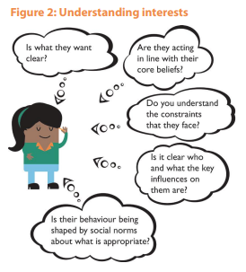
Understanding Interests: What makes people tick?
Notes:
Is what they want clear? Is it to secure a source of income? To secure power? To repay a favour? To make the world a better place? Is the person pursuing short- or longer-term goals? Are they focused on achieving one thing or lots of things? Are their goals aligned or in tension? Is the objective to block change or a reform / action or actually inaction? And how confident are they in their position?
Are they acting in line with their core beliefs? Does it seem likely that their apparent objectives are in line with their beliefs? People’s track records / past behaviour are important clues to this. Is what they say sincerely held or convenient rhetoric? What are the justifications given?
Do you understand the constraints they face? Are their decisions inevitable? Is there evidence that suggests that they view their position as constrained? Or could they be presenting the constraints strategically to avoid having to justify their decision? Are these constraints formal, legal rules or policies? And don’t forget the less visible but just as important informal or unwritten rules, such as the suki system in the Philippines – a ‘you scratch my back and I’ll scratch yours’ economic alliance system – or the wantok system in Melanesia, based on traditional norms around reciprocity and duty. Are these actually more structural factors – which serve to shape existing institutions – such as the class or caste system, the distribution of assets and land, demographic change or fiscal constraints, all of which shape the institutions?
Is it clear who and what the key influences on them are? Does their behaviour reflect the interests of others? Bearing in mind who they have to work with and report to, who are the other key stakeholders that they currently work with or are trying to work with (Figure 1)? How are these other individuals or organisations influencing them? Is this through sources of money, access to or security of employment, or other resources? Do others wield authority (traditional, political, religious or expertise) over them? Think outside the individual’s organisation / ministry. Have you considered both local and international actors, including donors? Do you as a player within this network (whether as an NGO, donor or individual) have any influence over outcomes? Are you skewing incentives?
Is their behaviour being shaped by social norms about what is appropriate? Which norms? Are they customs, cultural, ethnic, gendered, religious? Do the norms valorise or limit behaviour? How powerful and legitimate is the norm? Does the norm align with or cut against 1-4 above? Is it specific to their situation or a general societal norm?

Slide 17
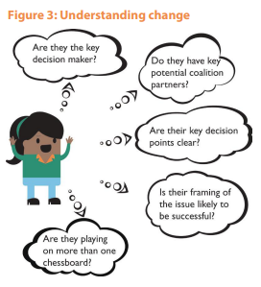
Understanding change: What space and capacity do people have to effect change?
Notes:
Are they the key decision maker? Who gets to decide, vote, sign off, fund, chair the process? This is not just about the formal decision-making chain but those people / organisations that hold informal power over a decision. Who could veto it? Can they influence these people? Do these other people influence them? This is critical to a political view of the world; we need to look beyond our usual focus on the poor and their (claimed) representatives, and ask who or what is key to effective change.
Do they have potential coalition partners? Are they trying to go it alone? Are there like-minded individuals or groups? Can they work beyond the usual suspects, e.g. private sector, the military, faith leaders? What’s the glue that could hold the coalition together? Do you know if there’s been a deal? Are interests aligned around an objective or values? Are they key brokers/‘kingmakers’ that hold different parts together?
Are their key decision points clear? What is the known timeline? Are there windows of opportunity? How many decision points need to be passed for them to achieve their objectives? Which decision points present the most risk to them achieving their objectives, and why?
Is their framing of the issue likely to be successful? Will they convince other powerful stakeholders that the change is in their interests? Does it resonate with local social and political norms? If it doesn’t, is it likely to provoke antagonism and backlash? Are they doing so on purpose?
Are they playing on more than one chessboard? Most people are trying to achieve multiple things at once. How do these relate to your reform? Successful mobilisation and influence means that individuals often have to play two or more games at once – pursuing one strategy with constituents and another with their colleagues in their political party or external players such as donors. Do you need to return to Step 1.1 to figure out if you are really clear on their objective(s)?

Slide 18
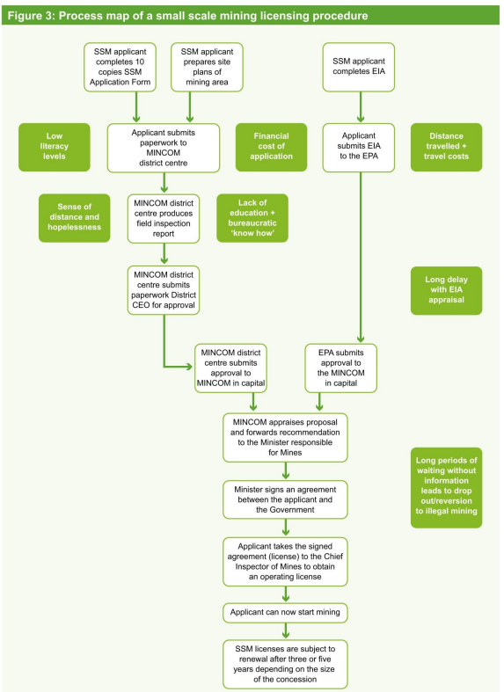
Other Questions to ask on Context
Is the problem one of a failing process? If so, worth doing some ‘Process Mapping’ (see →) to identify possible points of entry for influencing
Notes:
Process Mapping
Process mapping illustrates the network of flows of decision-making, resources, or information. It is a comprehensive flow diagram that can be used to identify bottlenecks and constraints and to analyse opportunities for changing processes to make them more efficient and effective. In PEA, process mapping can help understand how both formal and informal institutions affect the implementation or functioning of different processes, showing how processes are intended to work but also how they actually work in practice (e.g. as a result of institutional pressures and/or support). Process mapping is a very flexible tool and can be used to map a diverse range of processes, such as the budget process, acquiring planning permission, obtaining a driver’s licence, or informal flows of money in specific organisations.
Steps in process mapping
The following steps (adapted from Holland, 2007) outline a general approach to mapping an existing process (the ‘as is’ process). It can be adapted to suit the particular PEA objectives and questions, and the local context.
First, it is important to be clear about the process (or processes) to be mapped. It should clearly be directly related to the PEA objectives, focus, and questions but might have been identified beforehand (particularly if the process is a central focus of the PEA) or through the analysis of foundational factors or stakeholders (i.e. it might have arisen as an important process to understand more about during the ongoing analysis).
Once the process has been identified, it is important to define the objectives of the mapping more clearly too. Objectives could include, for example, understanding how the budget process works in a decentralised context; identifying opportunities for process improvement; identifying and resolving blockages or restrictions; understanding and reducing risks; or identifying entry points for engagement. Again, this will relate to the overall objective of the PEA and its focus and questions. Being clear about these will help ensure that the right level of detail is known. This could range from broad organisational levels to the fine details of a work process.
Once the objectives are clear, the starting and end points of the process can be defined (essentially the ‘boundaries’). This helps to avoid the process map moving beyond what is needed. Move through from the start point, identifying key steps or activities in the process as you go.
The data or information needed to complete a process map can come from three main sources: self-generation by teams or individuals, interviews and FGDs, and observation. In practice, this will depend on the process itself and on the PEA objectives and questions, but most information will probably come from the first two sources. In some cases, a review of manuals or policies and procedures will also help, particularly in identifying the formal process as it is meant to be.
Individual interviews with people directly and indirectly involved in the process will provide useful information for creating the map. Group interviews with a number of people (a sample or all) involved in the process can also increase the participation of different stakeholders in the actual mapping. When interviewing people involved in the process, ensure that they understand the objectives of the mapping and how it will be used.
It might also be necessary and beneficial to ask questions of people involved in the process about their experiences with it (such as problems they have experienced), areas they think can be improved, how the process might vary, if and how the process is done differently by different people, any steps they perceive to be unnecessary, and so forth. These responses will help identify areas of the process that might need improvement. Involve as many process stakeholders in the analysis as possible to get a wide range of perspectives. It is important to understand why a process is not operating as intended if improvements are to be made.
Process maps can use different symbols to show what occurs in the process. This can help in understanding what particular people do, or what particular activities are, for instance. However, it is sensible to keep the number of symbols as small as possible to prevent confusion. Process maps can become very complex very quickly. Develop rough drafts and revise them often as the map develops. Sticky notes or cards can also be useful when developing the map – stick the notes on a large sheet of paper or whiteboard and move them around (or throw them away) as the map develops.
Use concise sentences for each step in the process to show what is happening, where it is happening, when it is happening, who is doing it, how long it is taking, how it is being done, and why it is being done. This information will come from the sources discussed above. However, if there is missing information, then systematically asking these questions can also help show any knowledge gaps, which can then be filled by gathering further information from relevant people or sources.
Good analysis is key for a process map to be useful. Depending on the PEA objectives and focus questions, the following questions will help in developing and analysing the map:
What are the main steps and/or activities in the process? Who designed these steps/activities and who is implementing them? Who else is involved in each step/activity?
Which areas of the process are working as intended, and which are not? What are the repercussions? Why are they not working as intended? (This might bring in a range of information related to foundational factors and stakeholder analysis.)
Are there any wide separations of decision-making from process implementation?
Is there shared responsibility for steps among several people?
Are there excessive control points (e.g. many layers of approval), and what implications does this have? Who controls the process and what are their interests?
What value does each activity or step add?
Who benefits (e.g. which stakeholders)?
Could any steps be combined, run in parallel rather than serially, completed faster, or eliminated? Why aren’t they?
What linkages are there between different steps?
Taking into account this analysis, the map can be adjusted to incorporate any new information. This can be done on an iterative basis as needed, but it is useful to document any alterations fully so that it is clear who made the changes and when they were made.
Figure 3 provides an example of a process map of a small-scale mining (SSM) licence application procedure in a West African country. It was undertaken as part of a Poverty and Social Impact Analysis (PSIA) of a policy reform process related to the small-scale and artisanal mining sector. The map outlines the formal process but also some of the institutional factors that constrain the effective implementation of the process and its ability to deliver its intended purpose and outcome. It is interesting to note that these are not always technical issues or on the side of the process implementers, but are also related to capacity (e.g. financial and educational) of the process users, their feelings of distance and hopelessness, and their lack of knowledge, information, and influence. All these are key issues related to the political economy surrounding small-scale mining in this country.

Slide 19
And others – Lots to know about Context!
Windows of Opportunity
Is your proposed change likely to be opposed or unopposed?
What relevant national laws and regulations exist – are they being implemented?
Historical legacy
Ideologies, religion, culture, and values
Notes:
Windows of Opportunity: Examples include new governments forming, changes of leadership, crises and scandals, elections, the introduction of new technologies, shifting public attitudes and social norms, and external pressures from climate change.
Opposition v unopposed: If your campaign is likely to face opposition, you have to think about that. Can you counter their arguments? Divide opposition blocks and convince waverers? If it is unopposed, and merely an issue of moving something up the list of priorities, then that calls for different strategies – make it loud, convincing, feasible and urgent.
Laws and Regulations: If the PEA is concerned with a specific sector, understanding what laws and regulations formally govern the sector and how/why they are implemented, or not, is important. Many countries, while having a good track record on designing and enacting legislation, struggle with its implementation. This failure in implementation is often understood and communicated as a general capacity constraint (which is in many cases a valid argument). However, PEA can help understand the underlying issues behind policy implementation challenges (including capacity constraints). Questions could include:
What relevant laws and regulations exist?
How and by whom is legislative reform initiated?
Once in place, are laws being implemented? If not, what are the reasons (i.e. who is blocking it and why? what do they stand to lose? how big a role is corruption playing in this)?
Example: In Viet Nam, the ruling Communist Party has traded control of society for resources: foreign investment, international standing, and its own survival. This seemed to be going well, but now there are perceptions that the (central) State can no longer implement laws and policies effectively. Power has gradually shifted away from the Party towards the implementing agencies of government, and from the centre towards the provincial and local levels, who may selectively implement (or ignore) laws and policies to fit with their own needs and personal/factional interests. In other areas, the State has essentially ceded legal authority to citizens themselves (e.g. in the traffic management of Hanoi).
Historical legacy
Historical legacy, while part of the past, influences stakeholder behaviours in the present. Analysing historical trajectories is important, for instance, in helping to understand how a country’s institutions came about and how they are maintained. History can also include powerful factors that shape people’s current attitudes and can often take a long time to change. Questions could include:
Are there any previous historical events, issues, or factors (policies, programmes, reform initiatives) that influence current stakeholder perceptions?
How does a country’s political and historical background influence how stakeholders interact with one other?
Example: Preliminary insights from Myanmar show a great reluctance on the part of many citizens to engage with the State, e.g. in terms of actively trying to influence decision-making. Before independence in 1948, Myanmar was under British rule for many decades and then, following a coup in 1962, remained a one-party, military-led state for around 50 years. This historical lack of democratic tradition, plus the history of repression (e.g. through imprisonment of political opponents, violent suppression of anti-government demonstrations, periods of martial law) has left people inexperienced and lacking confidence in terms of using more recently available channels to voice opinions or concerns.
In Viet Nam similar issues are seen, with the capacity of coalitions of actors constrained by the historical and current political environment, limiting their experience in working together as a collaborative unit. Some negative side-effects of the formally socialist system have turned people off co-operation, while market reforms stress individualism and material accumulation. An echo of this effect is seen in the difficulty faced by projects seeking to support farmers’ co-operatives or community forest management: anything that looks or sounds like a subsidised co-operative is instantly viewed with suspicion by many citizens. Such attitudes are built up over many years and these historical legacies can take a long time to change.
Ideologies, religion, culture, and values
Similarly, ideologies, religion, culture, and values play an important part in how societies function. They also influence relationships and behaviours of different individuals and groups. Questions could include:
What are the dominant ideologies, religions, culture, and values that shape views and debates?
How have they shaped decision-making and political processes?
Do they represent a few or the majority?
Example: A study of Brazil’s political economy dynamics in urban sanitation investment found that the pluralism that characterises the country’s political system forces national policy-making to respond to competing, ideologically based pressures from pro-municipal municipalistas, pro-state utility estadualistas, and pro-private sector privatistas. These advocates mobilise support for their own ideologies across different levels of government and from different parts of political society, civil society, and the private sector, and can form tactical alliances around points of ideological convergence.
In another example, despite rapid material changes in Vietnamese society in recent decades, human relationships, alliances, and networks remain core aspects of the underlying political culture. There is also a cultural respect for hierarchy. If one knows (some of) the right people, one can get a lot of things done in Vietnamese politics and society outside of the written rules and established institutions. It is not only who you know that is crucial to getting things done, but the fact that some relationships are structured and linked to power. These relationships need to be used wisely to achieve public (and personal) purposes, while avoiding entanglements in the negative side of patron/client obligations.

Slide 20
Top Tips on Analysing the Context
Involve national staff and partners – they will have a much better grasp of interests, history and what is hidden, but understood
Don’t default back to formal power and institutions – keep informal power (behind the scenes influence, social norms etc) in your sights, at least for now.
Ditto culture and history – these shape how people see themselves and the possibilities of change. It’s not just laws and institutions.

Slide 21
4. Mapping the Stakeholders
Start with a list
For Visible/Formal power, plot columns 4 and 5 on a stakeholder map
For invisible power, use Rao and Kelleher
Stakeholder category | Relevant stakeholders | What kind of power do they hold? | Degree of influence over your desired change | Degree of agreement/disagreement with your goal | Who/what influences them?

Slide 23
Adapted from Rao and Kelleher, Gender at Work
Rao and Kelleher
Notes:
We introduced the gender and power framework – will look at this in more detail in a subsequent webinar
Looking at individual change and systematic change at the different levels and in the formal and informal spaces
With focus on in informal spaces on:
Consciousness: knowledge, skills, political consciousness and commitment to change toward equality
Cultural Norms: influences what changes are possible at individual level, some think most important
As well as access to resources and changes at the institutional level and in laws and practices
We need to understand what change is needed in all of the domains to plot our intervention and achieve sustainable change and long-term impact.

Slide 24
Top Tips on Stakeholder Mapping
Don’t just map formal institutions – think about the role of faith leaders/groups, norms, culture etc in driving/blocking change
Unpack monoliths, eg ‘government’, ‘civil society’ – different ministries or CSOs will have different interests, and be in different places on the 2x2 (eg spending ministries are often opposed by finance ministries)
Look for clusters of actors in similar places on the 2x2 – these are the building blocks of potential coalitions
Test and improve this with partners
Down the line, as your knowledge will improve and you will be able to revise and improve these analyses

Slide 25
5. The Bridge to Strategy
You can use your Context Analysis, Power Analysis and Stakeholder Map to come up with possible strategies for:
Insider reform efforts
Combined Insider/Outsider reform efforts
Broader attempts to influence social norms

Slide 26
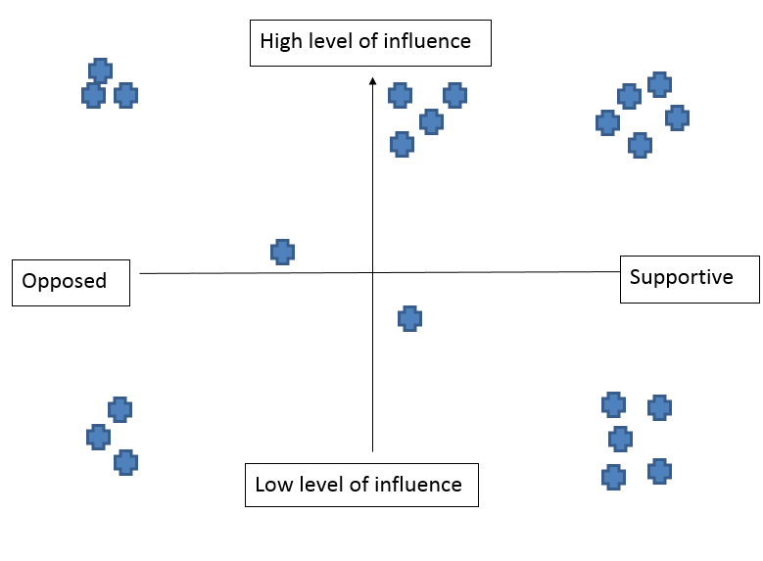
For the Influence/Interest 2x2, identify the clusters
D
C
A
B

Slide 27
Clusters → different possible Change Strategies
Group A: High Influence, High Support
Convening ‘unusual suspects’; Gap filling eg on evidence
Group B: Low Influence, High Support
Build Power With/ Within to increase confidence and organizational voice; link up to more influential players
Group C: High Influence, Low Support
Messenger not message; Seize Windows of Opportunity
Group D: High Influence, Opposed
‘Doubt is our product’; Discredit; Divide and Rule

Slide 28
For Rao and Kelleher, different tactics for each quadrant

Slide 29
Top Tips on Bridging to Strategy
Make sure your strategy(ies) follow from your analysis – don’t just default to what you would have done anyway!
Don’t default to formal institutions – you may want to combine influencing for them with outsider tactics and/or norm-shifting
Coalitions are usually preferable to going it alone – think about who/how to build coalitions. Where to you have convening power to pull players together?
Once you’ve identified target institutions, do another power analysis to identify who/what influences them (interests, players they respect/fear, narratives that resonate)
In future, what kind of analysis will help you refine your strategy? Include such ‘strategy testing’ moments in your plans

Slide 30
Putting it All Together
State the Problem, then Refine it through 5Ys and consultation
→ Initial Power Analysis disentangles different forms of power driving/blocking change
For Visible /Hidden Power, use Political Economy Analysis to dig into the context and identify possible ‘points of entry’
Map the stakeholders to identify clusters of potential targets and allies
Use this to shape your choice of strategies
Balance of Private and Public (lobbying, litigation, public media etc etc)
Narrative, messenger, timing, change coalitions, use of research etc etc
For Invisible Power, use Rao and Kelleher to do the same
The rest is up to you!

