Slide 1
MEL OF INFLUENCING TOOLKIT

Slide 2
0. ABOUT THIS TOOLKIT
0.1 Who is it usefull for?
0.2. What it contains?
0.3. How to use it?

Slide 3
0.1. Who is it useful for?
MEL practitioners and/or
Influence/Campaign coordinators-advisors from all around the confederation (at country/regional/global level)…
…with a medium-high knowledge and expertise on (MEL of) Influencing.
There are other available resources and options for support if you need more basic guidance, such as MEL of Influencing training courses and workshops (ask your regional/affiliate MEL Advisors), CAMSA, IMEL Community of Practice.
Notes:
Agregar algunas imágenes de personas? Ojo diversidad cultural
Respetar los links

Slide 4
0.2 What it contains?
This toolkit is grounded in a wide range of documentation that has been used for delivering workshops, presentations and background information of MEL of Influencing.
The idea of this toolkit is to offer the same-all content in a more dynamic, flexible format, so users can Access it in a more tailored way based on their specific needs and requirements.
It contains orientations, guiding questions, tools and methods, practical exercises on how to implement MEL of influencing initiatives autonomously (not P2P support available).
The same content can be found in other formats and spaces in the confederation, and it relies mostly on official materials and guidances that can be found in CAMSA.

Slide 5
0.3 How to use it?
(to be developed once the format is finalized)

Slide 6
1. Introduction
1.1 Influencing
1.2. MEL at Oxfam
1.3. MEL of Influencing

Slide 7
1.1. What do we mean when we say Influencing?
Influencing: systematic efforts to affect changes to policies, laws and regulations (and their implementation), and to budgets, company policies and practices, attitudes and beliefs in such a way as to promote more just societies without poverty.
Agregar alguna imagen de influencia: intentar no solo visualizar el trabajo de influencia política, sino también las redes y alianzas, la movilización social, la presentación en congresos, comunitario, etc.
Notes:
Puede que esta y la siguiente slide sean parte de una misma “visualización”, para poner en valor la definición y los principios… o ser 2 Slide distints

Slide 8
1.1. Oxfam’s Principles for influencing
Focus on poverty and injustice – All our work aims to eradicate poverty and injustice.
Women’s right at the centre – We put women’s rights at the heart of everything we do.
Social Accountability – based on transparency, feedback, participation and good MEAL (monitoring, evaluation, accountability and learning).
Change at all levels – We pursue change at local, national, regional and global levels.
Drawing on program experience – We speak with credibility and legitimacy because of our humanitarian assistance and long-term development programs and our partnerships and alliances at the local level.
Rights-based approach – We promote the entitlements of rights-holders and the responsibilities of duty bearers.
Evidence-based – We base our policy recommendations and positions on sound evidence. We don’t exaggerate.
Power analysis – We seek to influence those with the power to create change.
Principles and pragmatism – Strategic and tactical choices guided by most effective way to achieve change, in line with our mandate, organisational values and commitments.
Working with partners and movements – We work with partners, allies and social movements for greater impact.
Active citizenship – We strive to support the power of rights-holders and the connectedness between people North and South.
Community voice – We promote the voice of affected communities over our own
Notes:
Esta “slide” puede tener algo de interacción quizá? Que los ordenen de acuerdo a su propia consideración? La calificación o feedback al ejercicio no sería de “Bueno-malo”, sino quizá una reflexion en torno a que obviamente es dificil que un solo Proyecto o iniciativa tenga todas las piezas, pero que en la medida en que se logren incorporar más, habrá más posibilidad de lograr la influencia deseada, o algo así….

Slide 9
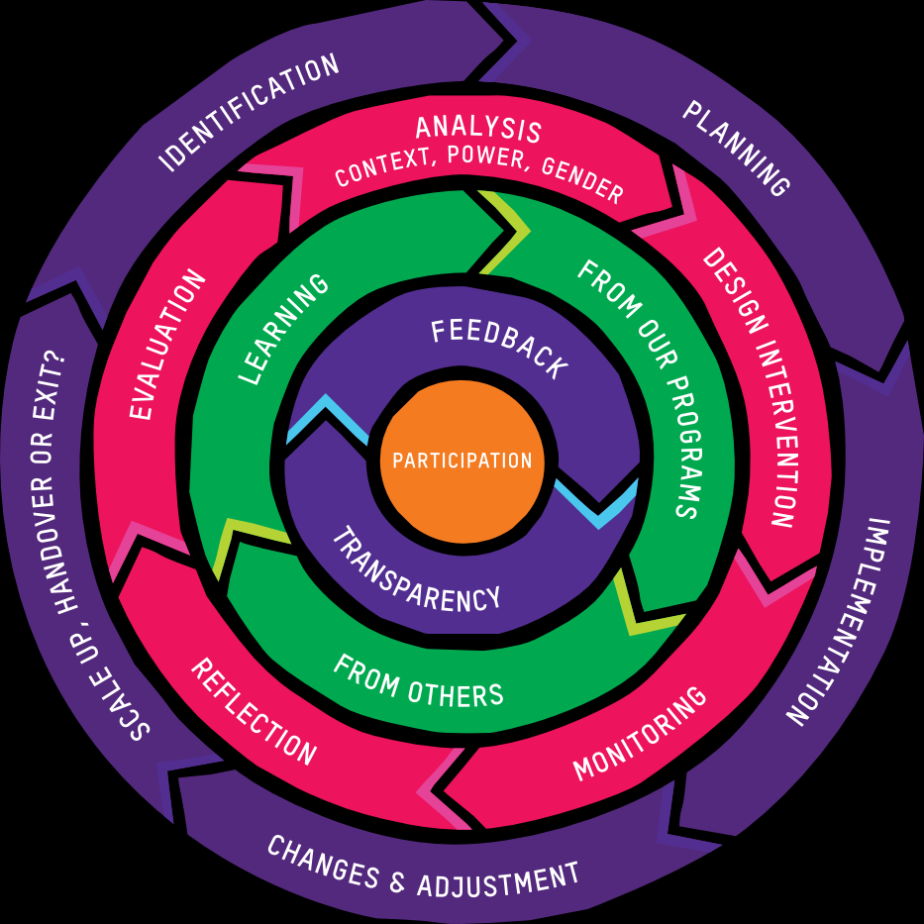
1.2. MEL in the Confederation
The Oxfam’s Confederation foundational requirements and suggested tools for MEL and Social Accountability are summarised in the Common Approach to MEL and Social Accountability (CAMSA). CAMSA articulates the purposes of MEL and establishes expectations for integrating MEL across the program, project and campaign cycle. The CAMSA expectations for MEL reflects and provides guidance for addressing the Oxfam Program Standards in your initiative.
LINK EXTERNO A CAMSA

Slide 10
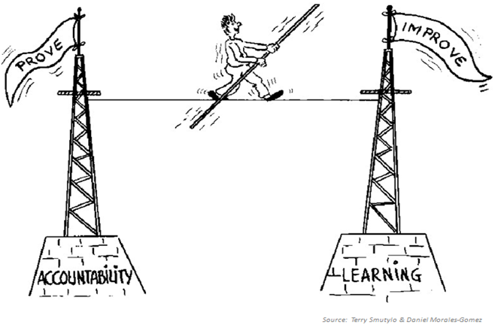
1.2. Why is mel important?
Increase effectiveness-Improving how we work
Build stronger teams & alliances
Improve & demonstrate impact
Build trust with stakeholders
Accountability to stakeholders, people who benefit and the general public
Resource mobilization
Understanding how change happens
Effective Monitoring, Evaluation and Learning (MEL) is part of and strengthens all stages of the design and implementation cycle. It supports Oxfam staff, partners and stakeholders to identify and communicate what the intervention is trying to achieve (goals) and how the anticipated change will happen (pathways to change) and, to learn about and test whether and how change is happening.
Notes:
La imagen puede estar de fondo o acompañando las piezas.
El recuadro en verde puede ser otra diapositiva o una idea que complemente las ideas de Porqué el MEL es importante…

Slide 11
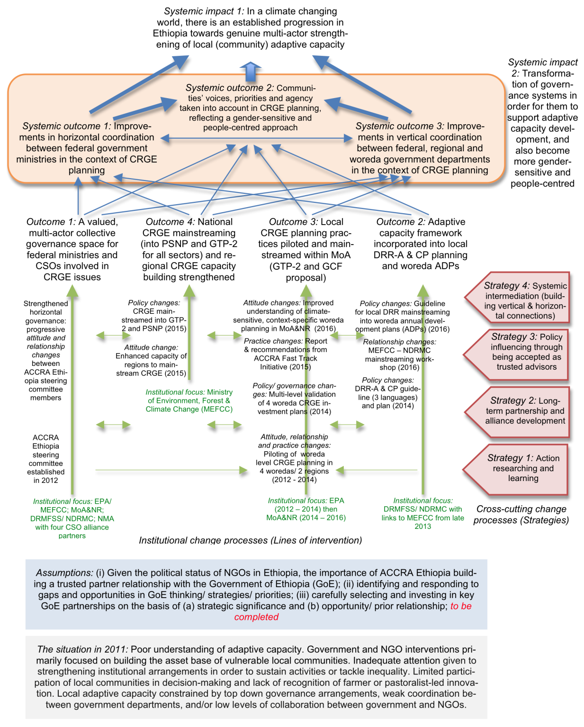
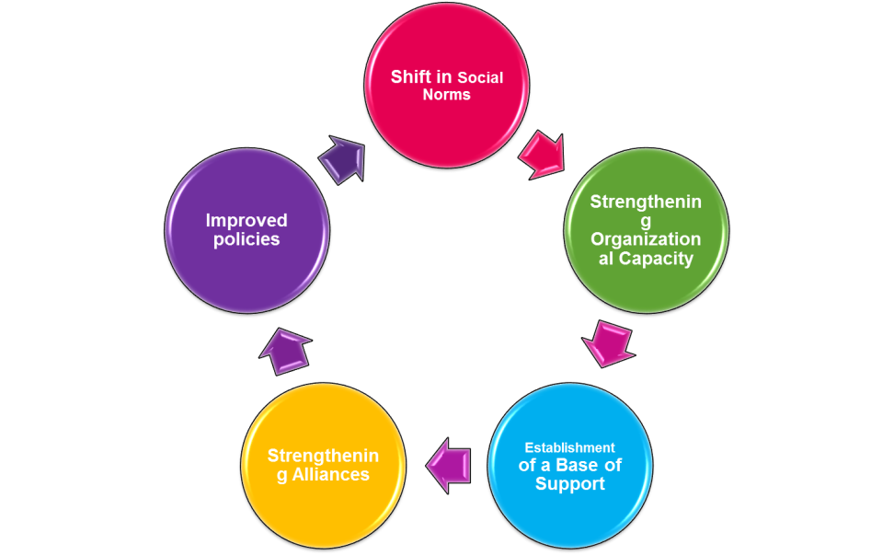
1.2. Prioritise the purpose of MEL …
Oxfam staff, partners and stakeholders are more likely to be excited about MEL that is engaging and useful eg if it supports collaborative processes to collect and analyse and make sense of the data that is then used to strengthen strategies and to demonstrate contribution to positive change.
Is the focus on measuring contributions to outcomes?
Or testing assumptions about how change is/has worked?
Notes:
Esta y las siguentes 2 diapositivas (3 en total) están relacionadas, porque hablan de que el MEL no puede medirlo todo ni responder a todo ni informar a todos… Que tiene que haber una priorización del (a) propósito, (b) de las preguntas clave, y de c) los stakeholders/audiencia. Por tanto, puede pesentarse como un “tríptico” o como slides separadas.

Slide 12
1.2. Prioritizing MEL questions
Which stakeholder/audience prioritizes this question/indicator?
Is this question/indicator mandatory for funding?
Would addressing this question/indicator strengthen implementation?
How would addressing this question/indicator increase our understanding of how the initiative is contributing to change?
Is this indicator/question gender sensitive or transformative?
How feasible is it to address this question/indicator within the resources available?
Can we address any ethical issues associated with addressing this question/indicator?
What is the priority for addressing this question/indicator – low, medium, high?
The best MEL focusses on the most important questions about how change is happening and how Oxfam and partners contribute to change. MEL doesn’t have to address every question at every level of a logical framework.
Notes:
Esta puede ser una diapositiva compuesta, o ser 2… la idea es que el MEL puede responder a muchas preguntas, pero probablemente no pude responder todas a la vez.

Slide 13
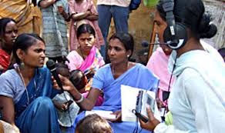
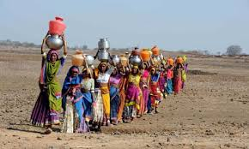
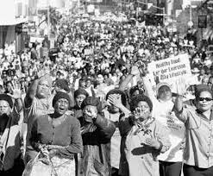
1.2. Clarify who the audiences for MEL are.
What their priorities are for data and analysis?
Notes:
Agregar más imágenes de lo que podría ser equipo técnico de Oxfam, o aliados o supporters…

Slide 14
1.3. MEL of Influencing
Influencing or engaging and supporting movements for positive change for marginalised people often takes place over many years, requiring multiple pathways and levels of change.
Different actors, events and initiatives may contribute to changes in norms, policy and practice, often in combination.
MEL of Influencing is both about what is measured (shifts in the distribution of power) and what is required to capture and use learning about change processes.
Opportunities to influence the steps towards the change may emerge when actors and factors in the external environment shift. This can require fast paced and intense influencing activity and MEL that supports real time learning.
When planned and managed well, MEL of Influencing enables evidence based real time learning and decision making (adaptive approaches) about the effectiveness of strategies and the strength and relevance of the assumptions in the ToC about how change will work.
MEL of Influencing approaches and methods support Oxfam and partners to develop evidence for the contributions of initiatives to sustained and structural change that can benefit many.
Notes:
Quizá esta diapositiva y la siguiente pueden estar relacionadas: esta es como la parte más expositiva-teórica, mientras qu ela siguiente intenta aterrizar algo más las diferencias-implicaciones (puede ser un juego interactivo de arrastrar)

Slide 15
1.3 How is influencing MEL different?
Aim is to shift power – how to measure?
Unpredictable dynamics – need rapid response
Working on indirect ways
Need to inform and influence others
Many actors and drivers – Oxfam just one player
Focus on reach, access & influence
Real-time learning tools
Difficult to track/ contribution
Invest in credible evidence/ research
Context & contribution analysis (not attribution)
Notes:
Quizá puede ser interactive? Hay cierta lógica entre las columnas (1→1), pero el enunciado no es tan evidente (por eso os dejo las notas originales de la diapo aquí abajo…)… quizá se puede hacer un juego de “ordenar” la segunda columna?
1. Influencing is about engaging power and shifting it to citizens and those who are marginalized and have no voice. An issue we face is what does power look like, and how do you measure it? → We focus on measuring three things — reach (How many people and who are we reaching?), access (What spaces are we gaining access to and shaping?), and influence (How are we helping change policies and practices?).
2. Oxfam’s influencing work operates in complex systems and the context dramatically changes all the time. You need to be able to respond and decide quickly on next steps. The MEL should enable staff to respond rapidly and make quick decisions — or risk missing the window of advocacy opportunity. → We have real time learning tools. Influencing MEL aims to be dynamic. We have to be able to reflect in real time, and not wait for the mid-point or end point of a project or an annual operating plan.
3 & 5. Influencing is usually done in coalitions and alliances, sometimes with partners, often with those who are not. At the same time, there are many actors outside the coalitions and partnerships who are also advocating for the same change. How can you consider and measure your impact if you are just one of the players? → We look at others’ contribution and do not attribute success or failure solely to our work, given that there are so many involved in the change. Change involves many valuable contributions from others, and looking at the overall context.

Slide 16
1.3. Challenges of Measuring Influencing
Complex causal relationships: Linking advocacy and outcomes is complex because of the non-leaner nature of change.
Complex interactions among myriad players and audiences: who are located along a continuum of engagement with policymakers—present greater challenges in capturing multiple stories and angles that often occur simultaneously. Involves more people and communities (breadth), and leads to more fundamental changes in the legal, economic and social structures of society (depth) than direct service work, which often addresses symptoms of social ills rather than root causes.
Long horizons/unpredictable time frames: Influencing work is long term. Change can be slow and incremental.
Subjective gains: Defining success is tricky and varies depending on who is asked.
Multiple approaches: Influencing makes use of multiple approaches including lobbying, advocacy, or campaigning. It may be difficult to assess which approach leads to impact.
Changing circumstances: Because of a fluid environment, work is rarely repeated or replicated and as a result, there is rarely an accumulation of knowledge. The goal posts can often shift depending on the circumstances.
Conflicting political process: Influencing often means engaging in a process that may have political consequences.
Lack of resources & guides and Limited organizational capacity: Until very recently, few resources existed to guide; Non-government organization’s (NGO) tendency not to evaluate their advocacy work systematically due to a lack of appropriate tools and frameworks to do so.
Fast implementation pace: Advocacy generally involves faster cycles of evolving strategies based on advocates’ need to react to opportunity windows.
Assessing progress vs measuring impact: impacts are gradual and happen over a long time
Attribution vs. Contribution
Source: ODI. (2014) Monitoring and evaluation of policy influence and advocacy.
Notes:
Sé que es mucho contenido, a ver que se os ocurre para presentarlo ;)

Slide 17
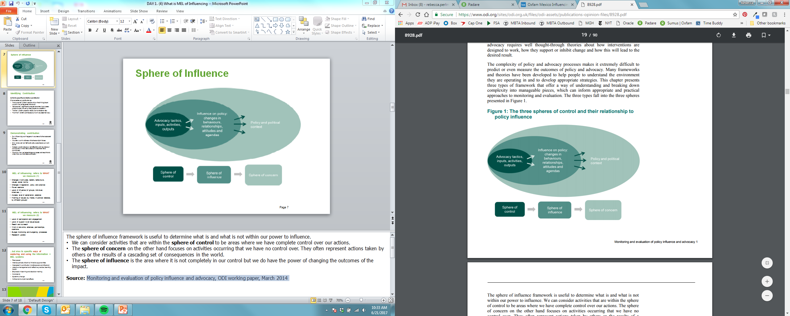
1.3. About contribution…
Our influencing work happens in a context of other actors and forces
We often work in alliance with others and join forces
Only rarely can we “attribute” influencing outcomes to our work alone.
Instead, we talk about our contribution, and we place our contribution in the wider context of what others have contributed
We show how we helped shape a process and result that is wider than our individual contribution
Oxfam’s specific and distinct contribution
Characterize our contribution as:
“Instrumental” (Oxfam was the only or the driving player; wouldn’t have happened without us)
“Substantial” (significantly shaped outcomes, but process predominantly driven by other players or a coalition)
“Visible” (Oxfam played a visible, but not decisive role)
“Nominal” (Oxfam contributed, but not in a substantial way).
Notes:
He mezclado 3 diapositivas en una, porque todas hablan del reto de medir la contribución de Oxfam… El diagrama (explicado debajo por si queries más detalle), habla de las distintas esferas de control de nuestra acción. El recuadro de la derecha (verde) habla precisamente de que ante la imposibilidad de demostrar atribución (porque trabajamos con otros, en contextos cambiantes), Prefereimos hablar de contribución. Entendemos contribución, al menos en 4 maneras (recuadro de abajo-naranja)
The sphere of influence framework is useful to determine what is and what is not within our power to influence.
We can consider activities that are within the sphere of control to be areas where we have complete control over our actions.
The sphere of concern on the other hand focuses on activities occurring that we have no control over. They often represent actions taken by others or the results of a cascading set of consequences in the world.
The sphere of influence is the area where it is not completely in our control but we do have the power of changing the outcomes of the impact.
Source: Monitoring and evaluation of policy influence and advocacy, ODI working paper, March 2014

Slide 18
Useful Tools and docs
CAMSA: Common Approach to Monitoring and Social Accountability
CAMSA applied to Influencing, Campaigns and Advocacy
Influencing for Impact, A guide and toolkit for influencing, advocacy and campaigning in Oxfam
Feminist MEAL
Feminist Guide for Influencing
Notes:
Para un menú lateral siempre visible durante toda la introducción

Slide 19
2. WHAT is it you will measure?
2.1 Teory of Change
2.2. Outputs, Ouctomes and Impact
2.3. indicators

Slide 20
2.1. Theory of Change

Slide 21
2.1. Theory of change
SELECT YOUR JOURNEY:
We asume that there is a ToC backing up the program, projecto, campaign or initiative that you want to undertake.
If that is not the case and you wish to build a ToC from scratch, go here (link to slides 20 To 28)
If that is the case, but you would like to review it as part of the evaluation-monitoring exersice that you are engaged on or in order to make MEL Plan, go here… (slide 28 to 29)
Notes:
Este es uno de los primeros elementos de “escoge tu camino”, debería haber una posibilidad de seguir 2 itinerarios según los intereses particulares, según se indica en el texto.

Slide 22



2.1 What is a ToC?
A Theory of Change is simply an on-going process of reflection to explore change and how it happens – and what that means for the part we play in a particular context, advocacy campaign or programme
CAMSA includes a series of indications and specific tools for desgining ToC in this link. A specific Step-by-step orientation can be found in this presentation (includes videos on slide 21 )
Notes:
Esta es una diapositiva que puede tener animación (que no es interacción ), pues el enunciado es corto, pero se explica bien desde las imágenes. Un proyecto puede a veces parecer una gota en el océano, pero a veces una gota puesta en el sitio y momento correcto son determinantes para favorecer un cambio.
La explicación original de los dibujos:
Sometimes Oxfam’s collaborative analysis with partners and stakeholders suggests that a target is almost ready to shift their policy and practice; all that is needed is additional perhaps targeted pressure or support. The core idea of the ToC may be that the system has shifted and additional focus on particular parts of the system will trigger the next steps towards change.
Examples may include that institutions and targets have shifted towards the change but have not yet committed or changed their behaviour or implemented the new practices. The theory may be that change will occur if the public and thought leaders are mobilised and evidence can be used to build pressure for the desired change.
An example of this type of theory is thought leader and consumer/public mobilisation or a boycott to pressure private sector to change their behavior. ‘

Slide 23
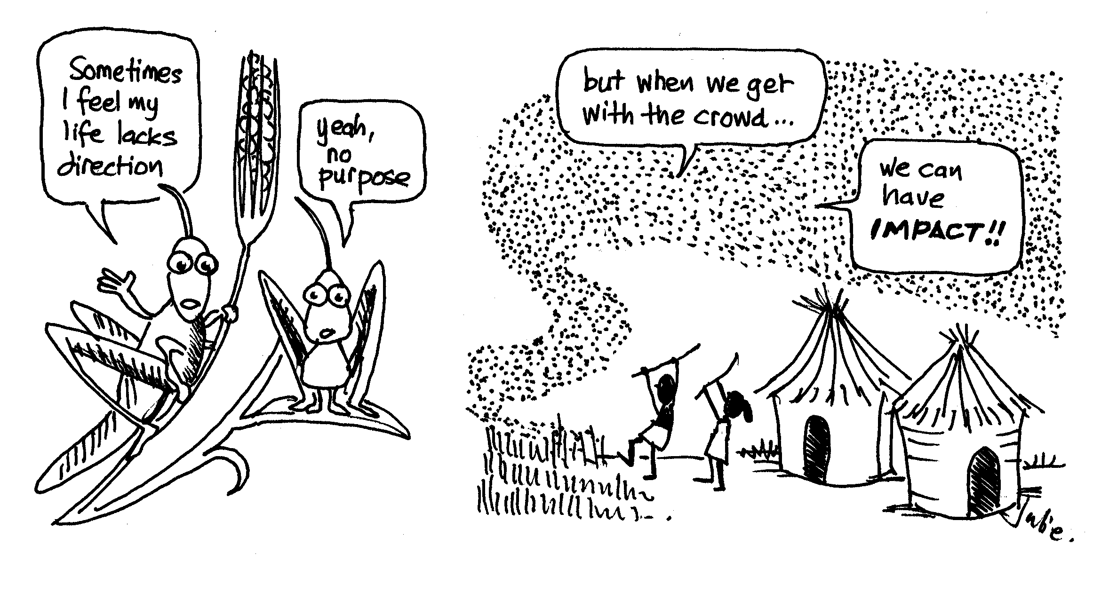
2.1 What is a ToC?
A ToC summarise Oxfam’s and partner’s beliefs about of how change will happen to drive desired transformations in people’s lives. It describes the pathways and interim changes that Oxfam believes will interact to contribute to desired outcomes. Involve colleagues, partners and stakeholders in the development of ToC: multiple perspectives expand and test our analysis and thinking.
ToCs are based on a series of assumptions about how individuals, groups, organisations and broader systems will respond to strategies and tactics aimed at changing attitudes, beliefs, behaviours and practices. They also communicates how Oxfam's initiative will contribute to the desired change for people and communities who benefit directly and indirectly (Theory of Action ToA).
Influencing is often used as a strategy in complex contexts where the pathways to change are multiple, emergent and often cannot be fully predicted. Informed by gender, political economy and power analysis, ToC can help to facilitate thinking and our ideas about how the efforts of multiple actors and pathways will interact to trigger a sequence of outcomes towards change.
Ideally ToC is not static but is updated throughout an initiative to reflect changes in learning and analysis about what works to trigger change.
Notes:
Son las ideas clave, se pueden presenter con cierto dinamismo? O separar en 2 diapos? Se puede usar esta imagen complementaria o buscar alguna otra…

Slide 24
2.1. WHY DEVELOP A THEORY OF CHANGE?
What is the relationship between ToC and MEL
Theories of change can:
Improve programme design by helping us to make more appropriate choices in approach based on the context
Make us think about power and how it works
provoke us to think about new ways of supporting change
Support us to surface and discuss our assumptions
Provide a framework for learning and adapting our interventions and for assessing our impact
Help to build common understanding amongst those who participate
Be used as a communication tool
Effective MEL facilitates learning and generation of evidence that, strengthens and challenges ToC particularly regarding assumptions about the change pathways and processes.
MEL helps Oxfam and partners to understand how power is shifting to enable change throughout implementation and whether and how outcomes are materialising as anticipated (or what unintended changes are happening).
Through MEL we can also analyse whether and how Oxfam are initiatives are contributing to the desired outcomes and change more broadly.

Slide 25
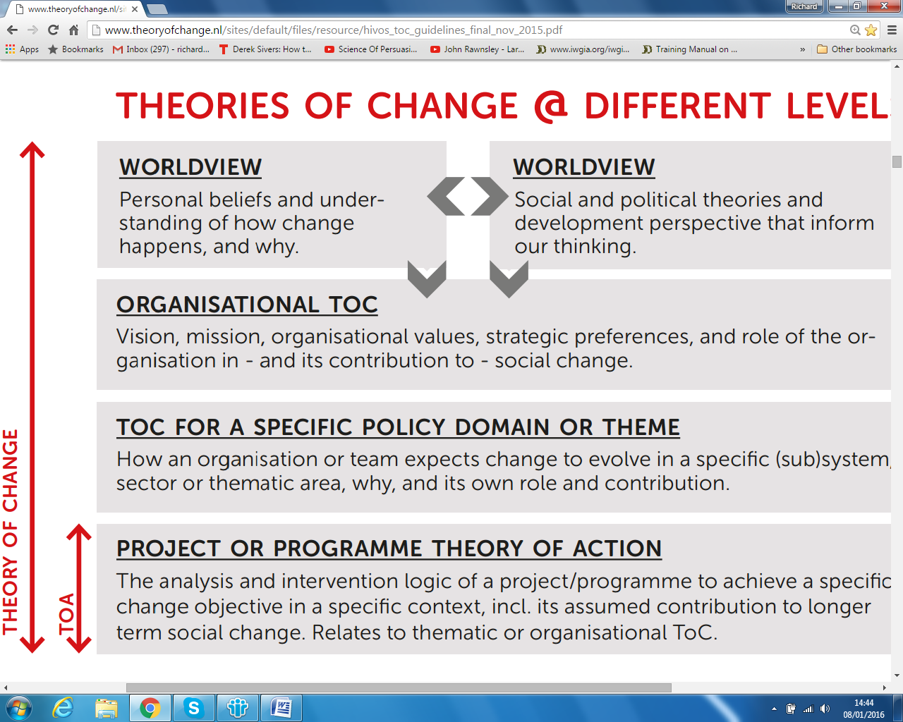
Notes:
Quizá esta gráfico se puede resumir o graficar de forma más simplificada para que no sea una slide diferentes sino una imagen complementaria a la diapo anterior. Solo sirve para decir que pueden haber Teorías de Cambio a varios niveles….

Slide 26
2.1. How to make a ToC: CHANGE PATHWAY
(Backward mapping)
Recommendations:
These ideas may help you get deep understanding of the system:
- Get perspectives from different people – people maybe you don’t normally listen to: decisions makers, experts, other people who work in your area, partners, staff, people who are affected by the issue
- Challenge yourself : “what am I not seeing”, “what do we still not understand?” Am I working with how change really happens or just with how I wish it happened?
1. Clarify your goal – ultimate impact that you want to influence/ achieve (write as results statement)
2. Identify long term changes that will support this goal and that you can influence (indirectly)
3. Work backwards: ask yourselves, in order for this to happen what needs to change (who would be doing what differently)?
4. Again: ask “in order for these changes to take place, what would have to be different ( who would be doing what differently – what would have to be in place? )
5. Once you have agreed and written up long, medium and short term changes, discuss and agree:
  Who you should be working with?
  What you should be doing with them?

Slide 27
Informed by gender, power and political economy analysis, ToC illustrates ideas about how change will work to address a development problem and summarises the causal pathways that an Oxfam initiative will employ to contribute to change. A MEL logical framework provides an explanation of the strategies within each causal pathway and that will contribute to ToC interim and higher level outcomes.

Slide 28
Example 1: GROW ToC
Impact (Long term goal) | Women and men living in poverty grow and buy enough food to eat
Outcomes (Objectives to be achieved) | Pillar 1: Agriculture and food production/consumption |  |  | Pillar 2: climate change |  |  |  | Pillar 3: Women and communities rights to land
 | By 2019, more government funding for small scale food production and a greater proportion of private investment in agriculture focused on helping, not harming, small scale food producers. |  |  | By 2019, communities that are vulnerable to climate change have greater access to adaption finance and other forms of support, and emissions from key sources are cut |  |  |  | By 2019, women and communities in at least 10 countries protect and realise their rights to land.
 | 10 GROW advocacy priority objectives 2016-19
Interim outcomes (results needed to contribute to objectives) | Alliances and networks with increased access to decision makers |  | Worldwide pressure on companies and governments builds |  |  | Shift in international debate in key forums
Outcome indicators --Examples-- (measures changes achieved) | Civil society partners are strengthened | Shifts in target policy and decision makers’ positions in favour of the poor |  |  | Number of cases of private sector actors adopting / implementing policies |  |  |  | Number of actions taken by GROW supporters
Output / process indicators --Examples-- (measures progress against inputs and activities) | Number of joint GROW activities with partners | Number of capacity building activities with various stakeholders / partners |  |  | Number of publications and products distributed |  |  |  | Number of people reached through media and social media
Notes:
Los 3-4 ejemplos que ofrecemos, en realidad pueden ser imágenes que estén en el menu lateral de Docs y tools…. Os lo paso así para que lo convirtáis en imagen…

Slide 29
Example 2: EVAWG Global ToC
Notes:
Idem

Slide 30
Other examples:
Notes:
idem

Slide 31
2.1. A ToC should be reviewed and updated regularly (So keep your Eyes and Ears open!)
It is important to have a dynamic view of your context (+ and – forces) .
 | If you are designing your ToC | If you are reviewing or updating your ToC
Critical junctures | Identify future windows of opportunity whether predictable (elections) or unpredictable (crises) | What critical junctures has the Project passed trhough? How they changed the scenario and the balance of power?.
Partners | what kind of partners can/will help us navigate complex, dynamic systems? | What new contacts, alliances have you generated? How are they affecting your possibilies to foster change?
Antennae | how do we detect when something is shifting in the external context, and react promptly to it? | Has there been any sudden change in context? Were you abele to predict and react? has it shown something that needs to be updated in ToC?
Notes:
Esta diapositiva es común para los 2 itinerarios

Slide 32
2.1. Key questions for reviewing or updating/refreshing your ToC
Strategic and focused objectives?
Are the objectives:
Derived from a solid, gender-sensitive background analysis?
- Are they SMART (specific, measurable, Achievable, Realistic, timebound)?
Strong gender perspective?
Is gender integrated in the background analysis?
Is it well reflected in the goals and objectives?
Is it followed through in the research plan?
Is it considered within the power analysis, and reflected in the budget?
Are women’s organisations strong in the alliance?
Strong power analysis?
Does the power analysis clearly identify the blockers, champions and swingers?
Are the chosen objectives winnable, or do they need revising?
Why is this alliance the right group of people for making that change happen?
Rapid
Appraisal
of
National
Campaign
Plans
Strategic alliance building?
What is the aim of the alliance?
Does it have the right people and skills to deliver this?
Is it focused enough to share specific objectives?
Is it clear how decisions will be made in the alliance?
Is it clear how information will be communicated across the alliance?
Do we have the money and capacity to make it succeed?
Focused Research?
Research for getting a strategic focus:
Will the answers to these research questions help to create focused campaign objectives?
Could the information be gathered in a quicker, lighter way?
Research for creating advocacy impact:
Is it strategic in what it aims to do, who it aims to influence and how?
How can allies be involved so they help produce the findings?

Slide 33
Useful tools and docs
Developing a Theory of Change, initial guide
Powerpoint – How to Make a Theory of Change
How to conduct a Rapid Appraisal of a National Campaign Plan,
Feminist approach to ToC
Rough Guide to Power Analysis + Advocacy Power Analysis Guide
Advocacy Power Analysis Template
Power Cube + Power Mapping Activity
Feminist approach to Power Analysis
Manual for conducting network mapping and social network analysis
Wheel of Impact Framework Guidebook (Coalition Capacity Assessment)
Examples of ToC (diapositivas 28-30)
Notes:
Este es uno reto importante, porque aunque bien puede ser una “diapositiva aparte” (la última de este bloque), también es cierto que podría ser una especie de “contenido disponible en una pestaña o bloque lateral”, siempre visible a lo largo de todos los contenidos de este bloque. El tema de las herramientas es central en un Toolkit, osea que me inclino más a la opción de que esté siempre visibile…

Slide 34
2.2. Ouputs, outcome, impact

Slide 35
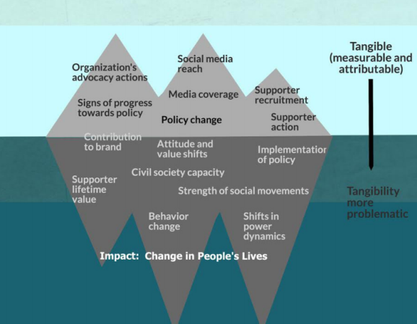
2.2. Measuring Outputs, Outcome and Impact
What to Measure
Source: Schlangen, Rhonda and Jim Coe (2014). The value iceberg: Weighing the benefits of advocacy and campaigning. BetterEvaluation. http://betterevaluation.org/sites/default/files/Advocacy%20and%20the%20value%20iceberg.pdf
Notes:
Esta imagen puede ponerse donde sea, porque sirve para ver los distintos niveles que implican los procesos de MEL de Influencia.

Slide 36
2.2. Definitions
What about Results?
Results is a wider concept that describes the desired changes (not our actions). According to OECD definition, all the Impact chain going from outputs to Impacts, can be considered “results”.
Unclear Definition Boundaries
As clear as it may seem, when working directly with different initiatives, the line of division between (activies) outputs, outcomes and impact may be blur. This is normal, because these definitions depend entirely on the logic of the program-intervention, and how the impact chain is described in each specific case.
Fuente: https://www.intrac.org/wpcms/wp-content/uploads/2016/06/Monitoring-and-Evaluation-Series-Outcomes-Outputs-and-Impact-7.pdf

Slide 37
2.2. Unclear definition boundaries
Exercises
How would you classify this? | Options | Answer | Final Answer (after completition of the exerc)
Capacity building | Activity | If we are talking about the number of workshops deliverd, and this dependes entirerly on Oxfam/parners to implement, then it is an activity. But if we are talking about the number of people participating then it might be considerd an Output. But if we are able to measure real capacity improvement or put into practice, than it can also be considered an outcome. | In order to facilitate a way of resolution when staff is having difficulties deciding on how to classify items in the impact chain, this is a proposed solution: define outputs as the effects or products delivered that are largely within the control of an agency; impact as the lasting or significant changes in people’s lives brought about by an intervention or interventions; and outcomes (that can be classified in different intermediate levels) are everything in between.
 | Output
 | outcome
Meetings with duty bearers | Output | If the meeting comes as a result of a set of different activities/outputs (capacity building on partners, movilization-signatures) and/or if they represent a shift in power relations, they can be consider an outcome. Sometimes meetings come as a direct effect of Oxfam influencing capacity put into action, or perhaps holding a meeting is quite normal, and it doesn’t express significant shift in power relations. If it doesn’t mean anything more than just “having a meeting”, it is an output.
 | Outcome
Policy Change | Outcome | Some campaigns may have policy change as its higher-top aspiration, but in a more long term visión, policy change means nothing (yet) until implemented an really provide life improvement.
 | Impact
Notes:
Este podría ser un ejercicio práctico, de clasificar los ítems según las opciones, y luego desplegar las respuestas. No hay correctas-incorrecta, pero sirve para la reflexión. Al final se puede mostrar la respuesta global.

Slide 38
2.2. Working with Outcome-Results
Outcomes are usually very important for an MEL System, because they provide early information on whether a project or programme is on course or whether any desired changes are beginning to happen.
If we waited to measure the ultimate impact of the project or programme without bothering to look at the outcomes, it might be to late to realize that we were not in the right track. Any MEL system or process designed to feed into management decision-making needs to assess outcomes on a regular basis.
Avoid M&E system that purely look at what is being delivered on the assumption that if products or services are delivered properly they will automatically translate into change.
PRIORITIZE OUTCOMES THAT…
You directly influence (rather than indirectly support)
Are important to your goal & mission
Are not too costly to measure
Will produce credible data

Slide 39
2.2. Outcomes Typology
There are different variables that can be used to classify or categorize outcomes:
Depending on the Type of Outcome (WHAT is changing?)
Depending on the Actor-stakeholder (WHO is changing?)
Depending on the Level of the desired change (TO WHAT EXTENT is changing?)
These ways of categorizing are complementary rather than excluding, and therefore they might be combined for properly definition of the expected results.
Remember to include a Gender perspective on your outcomes and results.
Notes:
Esta es como una diapositiva “introductoria” de las siguientes 3, donde se describen ejemplos de esas 3 categorías descritas. Sería genial que este fuera un contenido fijo (o repetido), y que luego las otras 3 se presentaran como contenidos intercambiables.

Slide 40
2.2. Typology according to WHAT changes (Outcome Domains and outcome examples):
Framing of issues (by media, in political debates, by different groups)
Changes in attitudes, beliefs, behaviours, values, social norms
Shift in Social Norms
Shift in Capacity
Base of Support
Alliances
Improved policies
Power relations
Changes in legislation, policy and practice
Reach and outreach
Budget monitoring and budgeting processes
Research uptake
Access, level of penetration, salience
Level of influence (of groups, individual, initiatives...)
Work in networks, alliances, partnerships, coalitions
Level of support to an issue/cause
Level of participation and engagement
Source: Harvard Family Research Project. (2007) A Guide to Measuring Advocacy and Policy, The Evaluation Exchange, Volume XIII, Number 1&2, http://www.hfrp.org/evaluation/the-evaluation-exchange/issue-archive/advocacy-and-policy-change/a-guide-to-measuring-advocacy-and-policy
Notes:
Esta puede ser una actividad interactiva, que intenten colocar los Ejemplos asociados a las áreas-dominios que pertenecen… es un ejercicio un poco complicado, porque hay algunas que podrían estar en varias (access, level of penetration), y otras que están entre 2 (p.ej Level of influence o power relations o level of participation),

Slide 41
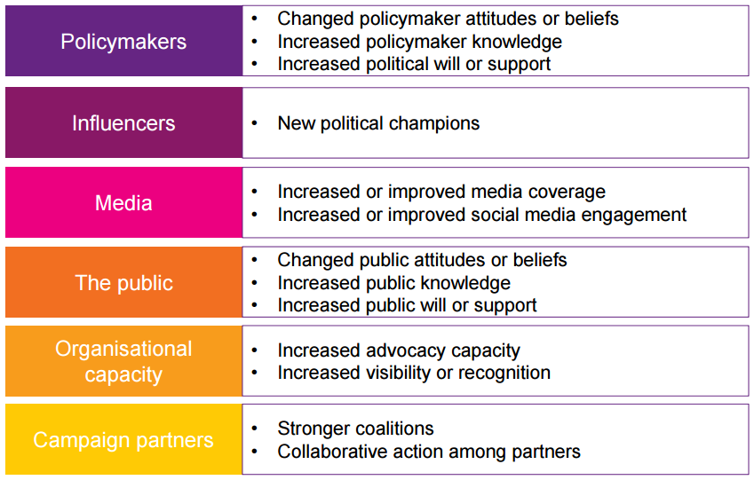
2.2. Typology based in WHO is changing? Examples of stakeholders and outcomes

Slide 42
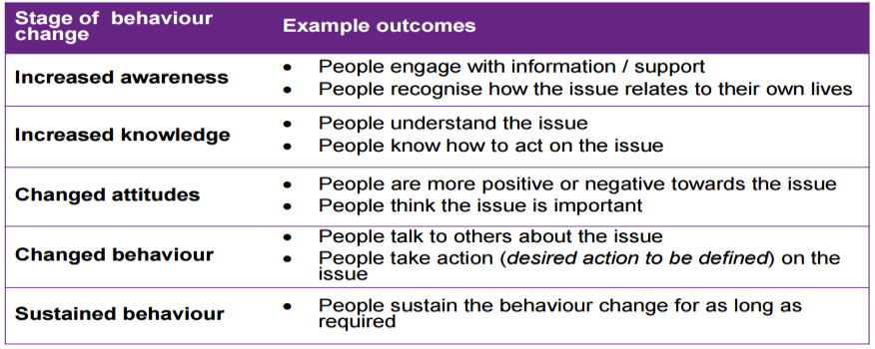
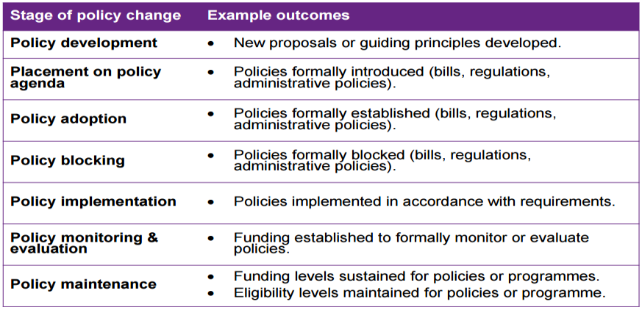
2.2. Typology based on levels of change (includes examples):
Outcomes to measure BEHAVIOR change
Outcomes to measure POLICY change
Notes:
Estas 2 y la siguiente son tablas con la idea de mostrar como los outcomes pueden esablecerse desde una lógica de varios niveles dentro de un continum o serie de cambios.

Slide 43
2.2. Typology based on levels of change (includes examples):
Outcomes to measure PUBLIC/DIGITAL ENGAGEMENT
State of Public | Exampla of outcomes
Exposure | People attending a conference People reached on Facebook
Engaged | Interactions in social media, People participating in a demostration
Conversion | New petition sign-ups Becoming a multiplier
Loyalty | Constituency supporting public actions Activists engaging in lobby
Notes:
Una tercera tabla similar a las 2 anteriores.

Slide 44
Gender Outcomes
Example:
Number of CSOs who report increased engagement with decision makers.
Gender-blind: Recognize no distinction between the sexes. Make assumptions that lead to bias in favour of existing gender relations (and so tend to exclude or disadvantage women.)
Gender-neutral: Use knowledge of gender differences to overcome biases in development interventions, to ensure interventions target and benefit both sexes to meet their practical gender needs. Work within the existing gender division of resources and responsibilities.
Gender-specific: Use knowledge of gender differences to respond to the practical needs of women or men: work within existing gender division of resources and responsibilities.
Gender-redistributive: Intended to transform existing distributions of power and resources to create a more balanced relationship between women and men, touching on strategic gender interests. May target both sexes or women or men separately.
Avoid gender blindness.
What is this not telling us?
Example:
Men and women report participation in community water management committee.
Will they see benefit differently? Ask separately.
Example:
Proportion of women who report easier access to water for washing, cooking and drinking.
Assuming this is women and girls’ responsibility
Example:
More partner CSOs employ women in project roles.
Assuming this is a meaningful change in women’s traditional roles.
Adapted from “Key Concepts” section in a Guide to Gender Analysis Frameworks, from Kabeer (1992)

Slide 45
Useful tools and docs
EVAWG global MEL Framework offers a good example of a comprehensive ToC depicting outcomes at different levels. (pp.19-20)
MEAL framework GROW campaign is another good example of detailed multiple level ToC with good examples of outcomes and outputs
Examples of Outcomes, outputs and Indicators for Influencing
How to develop Outcomes that are gender sensitive?
Notes:
Idem que los otros que tienen este titular. Tendría que estar en un menú lateral siempre accesible en este “apartado”

Slide 46
2.3. Developing Indicators

Slide 47

What is an indicator?
Specific
Measurable
Achievable
Relevant
Time bound
Quantifiable, capable of being evaluated, measure success. What type of change or changes do you want to influence and in whom or what?
The indicator is feasible to monitor because the information is available and change can be detected.
Indicators need to be relevant to the context, to what the program is working on and to the outcome/objective being measured.
Provides a measurement at time intervals that are relevant and appropriate in terms of program goals and activities.
It is clearly defined and not vague about the change being measured. The more precise your indicator, the easier it is to measure. It makes it clear what kind of specific evidence is needed.
Gendered
An indicator is a unit of information, which measured over time, would depict the change in a given condition.
Strong indicators clearly describe what we will measure to monitor changes in the context, actors and institutions that we assume need to change to enable the desired outcomes. Indicators can be designed to measure and contribute to learning about what has changed and is contributing to the change
Notes:
Esta diapo necesita rediseño, mucho contenido… son importantes los 2 recuadros, pero también es importante qe el acrónimo de indicadores SMART se explique bien…

Slide 48
Key Concepts
Focus on Change - focus more on the change in our activities, products, processes, etc.
Assess progress - We set goals to assess progress and challenges over the initiative
Use mixed indicators - quantitative and qualitative
Context specific - ideas and examples are to be adapted
Focus on intermediate indicators - We identify critical steps of the theory of change and focus on them.
Notes:
Incluir alguna imagen?

Slide 49
Prioritize Indicators That…
You directly influence (rather than indirectly support)
Are important to your goal & mission
Are not too costly to measure
Will produce credible data
Provide the best, more efficient, proportionate way of giving us the information we need
Are closely related to what we want to measure
Describe what we will measure (not the target)
Are gender-sensitive
Notes:
Quizá agregar alguna imagen

Slide 50
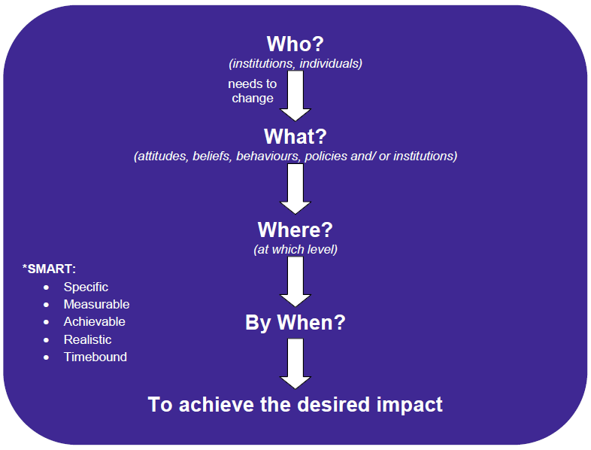
What does an indicator include?
Notes:
Simplificar el diagram para ver si se puede vincular a otro

Slide 51
Gender Indicators
Example:
Number of CSOs who report increased engagement with decision makers.
Gender-blind: Recognize no distinction between the sexes. Make assumptions that lead to bias in favour of existing gender relations (and so tend to exclude or disadvantage women.)
Gender-neutral: Use knowledge of gender differences to overcome biases in development interventions, to ensure interventions target and benefit both sexes to meet their practical gender needs. Work within the existing gender division of resources and responsibilities.
Gender-specific: Use knowledge of gender differences to respond to the practical needs of women or men: work within existing gender division of resources and responsibilities.
Gender-redistributive: Intended to transform existing distributions of power and resources to create a more balanced relationship between women and men, touching on strategic gender interests. May target both sexes or women or men separately.
Avoid gender blindness.
What is this not telling us?
Example:
Men and women report participation in community water management committee.
Will they see benefit differently? Ask separately.
Example:
Proportion of women who report easier access to water for washing, cooking and drinking.
Assuming this is women and girls’ responsibility
Example:
More partner CSOs employ women in project roles.
Assuming this is a meaningful change in women’s traditional roles.
Adapted from “Key Concepts” section in a Guide to Gender Analysis Frameworks, from Kabeer (1992)

Slide 52
Examples of indicators
Quantitative
Qualitative
% Increase public spending on healthcare
Number/% of households covered by a service
Index rating, position in ranking
Number of complaints or reports received
Prevalence rate
Number of pieces of research
Number of people trained
Number of meetings
Level of transparency of budgeting process
Level of participation of citizens, women, in decision-making process
Quality of the service provided
Level of awareness of their rights in a particular issue
Capacity to influence/Level of influence
Intensity to which a given issue is given media coverage
Self-perception of agency
Notes:
Es un poco obvio, pero quizá un juego de ordenar los indicadores según sean cualitativos o cuantitativos?

Slide 53
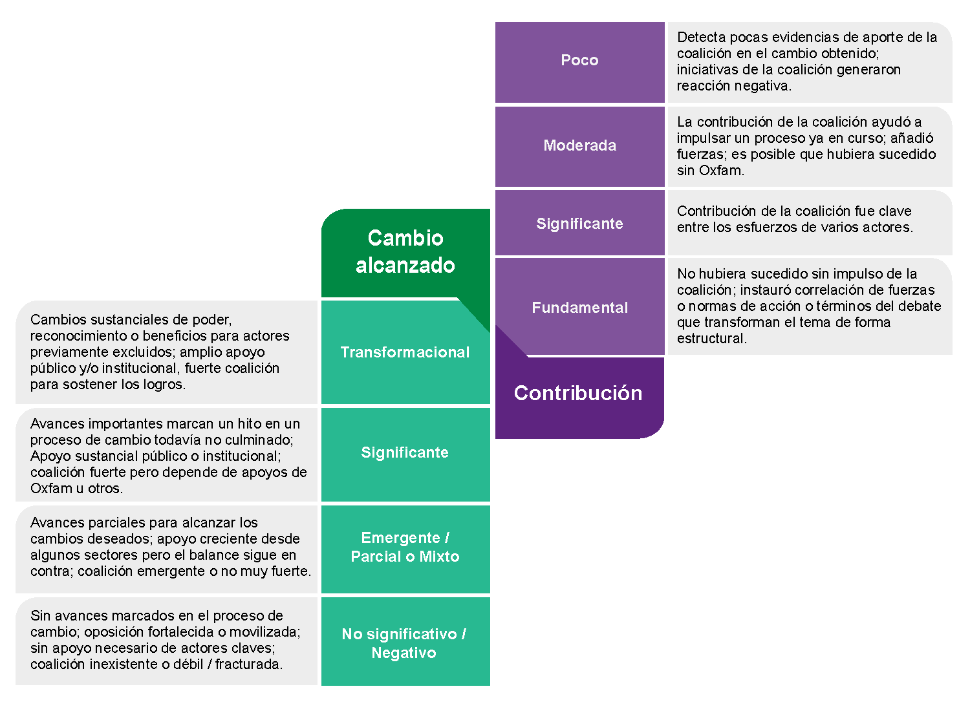
Narratives of Success
Dealing with qualitative indicators requires pre-defining a “Narrative” that helps us interpreting then in relation to our expected results.
The narratives of success serve as a basis, or a reference, for when the team reviews what has happened and try to assess if they have achieved what they aspired for.
They can also help formulate more accurate indicators. In this way, they serve as an intermediate step in developing of indicators, helping the team to specify more what they aspire to achieve.
Notes:
Estos son 2 ejemplos de narrativas de éxito, que no he podido traducir, os la paso así y en breve os paso la version en inglés.

Slide 54
Useful tools and docs
EVAWG global MEL Framework offers a good example of a comprehensive ToC depicting outcomes at different levels. (pp.19-20)
MEAL framework GROW campaign is another good example of detailed multiple level ToC with good examples of outcomes and outputs
Examples of Outcomes, outputs and Indicators for Influencing
How to develop Outcomes that are gender sensitive?
Notes:
Idem que los otros que tienen este titular. Tendría que estar en un menú lateral siempre accesible en este “apartado”

Slide 55
3. HOW will YOU MEASURE?
3.1 Setting up a MEL Plan
3.2. Monitoring; when and how
3.3. Evaluation: when and how
3.4 Learning: when and how
3.5. Roles and responsbilies

Slide 56
3.1. Setting up a MEL Plan

Slide 57
Data Collection Plan
Once you have your ToC, depicting the chain of outputs-outcomes that you foresee to produce, and the corresponding indicators for assessing performance, you will need to develop a Data collection Plan including:
Which the indicator(s) or outcome area(s) they will track;
What data needs to be collected;
How it will be collected;
When it will be collectedly - how frequently (e.g. quarterly, weekly);
Who will be responsible for collecting it and how it will be used.

Slide 58
Data Collection Plan template
Hierarchy of objectives (impact, outcome or output) | indicators | Baseline (if possible) | Tools/method of verification | Frequency of data collection | Responsibility | How to share the information ( report/ presentation )
You can download this template and use it in the following way
Start by filling the first two columns with the Outcomes and indicators that you have been reflecting/identifying or that were originally included in the ToC.
As the content of the following chapters will be offering ideas on tools, methods, tips, go on filling the corresponding columns.
Go on saving the document locally
Afterwards you can print it, validate with team and collaborators, and continue editing it.
Notes:
Aquí tendría que haber un link a un PDF editable, que tenga más o menos esta estructura. Habíamos discutido sobre la posibilidad de que fuera un document “online” que se pudiera ir guardando, pero creo que lo más eficiente va a ser un document tipo PDF editable, que una vez descargado, se pueda ir “rellenando”, pero que se archive o guarde en local para seguir editando más adelante y para poder imprimir.

Slide 59
Key Ideas when filling the Outcome and indicators columns
Where possible the data should be a mix of qualitative and quantitative information. The indicators will focus primarily on the interim outcomes identified in the logic model. Teams may choose to include output or strategy level indicators to supplement (but not replace!) outcome monitoring.
The data collection plan will give the campaign team a guide on what information to monitor. Teams should be looking to collect the minimum amount of information needed to give them a sound understanding of campaign progress, so will need to be selective in deciding where to invest in tracking and analyzing data. Teams should document information on the campaign’s activities/outputs (such as numbers involved in mobilizations, media coverage of events) and campaign outcomes (such as shifts in decision-makers positions, changes in public awareness and engagement.
As learning is an Ongoing process, there are a few monitoring tools that are focused on turning data-evidence into Learning. Be sure to include some of these tools in your MEL Plan
Also include Evaluations in your plan, at least a final one, but it is recommended to also include mid term. Evaluations will benefit from all the information gathered by ongoing monitoring, but they will help you to answer more complex questions about higher level outcomes, assumptions, etc.

Slide 60
MEL components are part of the Data collection Plan
  M-stands for Monitoring
E-stands for Evaluation
L-stands for Learning
You probably have seen the acronim MEAL also widely used, where
  A- stands for Accountability
  However, as important as it is, Accountabilty actions/activities are not often included in the MEL plan, as it is mostly focused un Data collection.

Slide 61
3.2. Monitoring

Slide 62

MEL as a Cycle
MONITORING
Like a dashboard of a car that gives regular
“readings”
A continuous function to provide early
indications of progress – or lack thereof
– in achievements of results
.
project design including ToC, MEL Plan, Baseline
Monitoring
Learning
Monitoring
Learning
Evaluation (half way mark)
Monitoring learning
Monitoring Learning
Evaluation
(endline)
Notes:
Esta y las siguientes diapos, se basan en la mismo diagrama y va cambiando el texto, quizá sería bueno que la parte que se describe en el texto, cambie de color en el diagrama, para facilitar…

Slide 63
Ongoing Monitoring – Useful Questions
Question | Suggestions
What are you already collecting? | Who might already be collecting the data you’re choosing? For example, does your advocacy lead keep records of correspondence with policy contacts? Budgets can be used to document campaign investments.
What can be automated? | How might you change your working style or use basic tools to help you regularly collect data, without much effort? For example: Adding important data to regular meeting minutes – so documents that would normally be saved anyway can also double as MEL tools. Free electronic data-collection tools (email accounts, RSS feed collectors, etc.) where you can easily forward monitoring information.
Which different perspectives are included? | Which perspectives are missing? Don’t forget to include some outside perspectives, so voices other than from Oxfam are included. You might do this by: Creating feedback tools for campaign participants (e.g. storing all Facebook comments) Actively soliciting input from people outside the organization.
Is this too much information? | Make sure to collect only as much data as you can review and reflect upon in the team! It is better to collect information on a few indicators in a systematic way over time than collect information on a number of different indicators in haphazard way.

Slide 64
Useful tolos and Docs
After Action Review & Debrief Guide and Template
Template to document peak achievements
Tool to assess the effectiveness of tactics
Creative Products Tracking Guide
Lobby meeting tracking sheet ex 1
Champion tracking tool
Media monitoring template
Digital and Social Media MEL Toolkit
Digital and social media monitoring template
Citizen Report Card
Print Media Monitoring
Measuring behavioral change handout
Mobile Survey Toolkit

Slide 65
3.3. Evaluation

Slide 66

MEL as a Cycle
Evaluation
Like a thorough check-up of a car - an in-depth inquiry.
A selective process to systematically assess progress towards the achievement of outcomes & to test the effectiveness of strategies.
project design including ToC, MEL Plan, Baseline
Monitoring
Learning
Monitoring
Learning
Evaluation (half way mark)
Monitoring learning
Monitoring Learning
Evaluation
(endline)

Slide 67
Evaluation can serve different objectives…….and….. stakehoders:
Accountability
Testing & developing models (scaling up)
Learning and streghtening project implementation
Program development and decision making
Sharing evidence
Oxfam
Partners
External Audiences
Donors
Testing & developing models
Learning
Program development
You may need to make explicit options to prioritize the objectives and focus on specific stakeholders.
Notes:
posible juego? En base a su experiencia o intuición, unir el tipo de objetivo con los stakeholders a quienes les podría interesar más dicho objetivo. No hay solución “Buena”, porque en realidad puede haber multiples cruces, pero al acabar de unir cada objetivo, se puede ofrecer una ventana con contenido complementario como:
Accountability … evaluations can be designed to contribute to Oxfam’s ability to demonstrate that Oxfam projects are progressing towards agreed changes whether that is policy change, reversal or maintenance or for example in the capacity of civil society and communities ability to influence. Evaluations can contribute to engaging & communicating with stakeholders – communities, partners & donors about project progress.
Testing & developing models … evaluations can contribute to the evidence base for a particular approach or model. Oxfam has used evaluation to develop test & develop models for projects that aim to reduce the acceptance of violence against women and girls.
Learning … evaluation of change mechanisms and processes can contribute to our understanding of how the project causal mechanisms are working or how the project is contributing to the desired changed … or not.
Program development … based on learning, evaluations can be designed to support decision making about how to develop programs. This may include adjusting project strategies or making more significant changes to the project outcomes, ToC & strategies

Slide 68
Prioritise the focus …
We can measure outcomes…
Test assumptions …
Notes:
Depending on the priority users & uses & the evaluation purpose & type, we have a range of options for focussing the evaluation. An evaluation that is focussed on accountability & that is largely addressed to a donor as a key audience may focus on assessing progress towards outcomes.
A more learning focussed evaluation where Oxfam & partners are the key audience may be more concerned with testing assumptions or understanding how the project is (or not) contributing to the desired changes.
In the early stages of planning an evaluation it is important to clarify whose needs and interests are we addressing with this evaluation? We also need to ask what are the key questions that audience is interested in? Of course, ideally the development of an evaluation ToR involves key audiences and users.

Slide 69
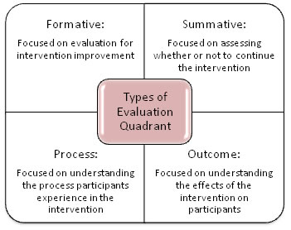
Clarify the evaluation type …
Clarifying the evaluation type will help you to understand the evaluation purpose and also how to focus and frame the evaluation questions. Some evaluations will address more than one evaluation type. Eg evaluations that aim to analyse outcomes will also be focussed on how the project contributed to the outcomes.
Notes:
Esta es información complementaria que debe mostrarse para más detalle del diagram.
Formative evaluation is usually conducted relatively early in project implementation. These evaluations provide analysis that helps to strengthen project strategies and implementation.
Process evaluations investigate implementation eg participants or partners experience of a project.
Outcomes evaluations focus on the project contributions towards anticipated or desired change that has happened in the life of the project eg the extent to which a project has contributed towards changes in attitudes & norms or has contributed towards a campaign target eg raising the visibility of an issue in the media.
Summative evaluation is also called impact evaluation or ex-post evaluation. It focusses on the net effect of an initiative and asks about the sustainability of the effects.

Slide 70
Matching the evaluation type to key questions that you wish to answer…
Notes:
The evaluation type shapes and guides the focus of evaluation questions …

Slide 71
Tips for good evaluation questions …
Link questions to the evaluation purpose
Questions should either
  Describe what has happened during implementation
  Compare the intended strategy or result with what has happened
  Ask what contribution the intervention has made to the result
Ensure that the questions can be answered
Focus on one issue per question
Ask open not closed questions
Emphasise inclusion and explicitly direct attention to the range of stakeholders that are involved in the project
Useful questions to ask/check your questions
Which evaluation purpose does this question address?
Which stakeholder would use the information?
How would they use the information? What kind of decisions could they make with this evidence?
Would an answer to the question strengthen our understanding of how change is happening?
Would the answers to the question strenghteng our evidence base?

Slide 72
Match methods to evaluation
Purposes: Think about which method will address your evaluation purposes … which methods are best for assessing processes and which for outcome/impact?
Uses: Consider what kind of data and analysis each method will generate. Do you need quantitative or qualitative analysis or both? Do you need to demonstrate evidence for Oxfam and partners contribution to a policy change … what methods are best for providing evidence of contribution to a policy change? Or what methods will help you to show how your initiative contributed to changes in gender norms and attitudes?
Questions: which methods will address your prioritized questions
Resources: how do your resources match to the resources required to use available methods? What kind of skills and expertise is needed to use available methods? How much time is needed to plan and implement the method and analyse the data?
Notes:
Not all evaluation methods are relevant and useful to all evaluations.
Purposes
Uses Questions ….
Resources

Slide 73
Useful tolos and Docs
Oxfam Evaluation Guidance
Process tracing protocol
Outcome Harvesting Guidance
Contribution Analysis
Rapid Outcome Mapping Approach

Slide 74
3.4. Learning

Slide 75
MEL as a Cycle
LEARNING
The process of making sense and utilising information gathered through M&E and processes to inform decision making, program development & future initiatives.
Is the knowledge, evidence which informs programme design and practice
...it emerges from programmes
... is captured and shared to improve practice
... is a way of thinking, doing and seeing the world.
... is not turned off and on, but is regular, on-going and iterative
project design including ToC, MEL Plan, Baseline
Monitoring
Learning
Monitoring
Learning
Evaluation (half way mark)
Monitoring learning
Monitoring Learning
Evaluation
(endline)

Slide 76
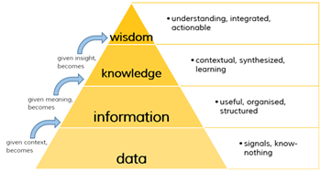
The process of learning…..
Notes:
Esta diapo y la siguiente son formas complementarias de entender el proceso… buscar una manera de combinar los 2 diagramas y la explicación que aparece en las notas.
Learning is a process. When we learn,
raw data is processed so that
it becomes useful, structured and organised information and
then given meaning so that it is contextualised and synthesised into knowledge and finally
becomes wisdom which is integrated into our understanding and becomes actionable in the form of new behaviour, capacity or skills

Slide 77
Another way of representing the learning process …
Notes:
This slide presents the learning process using the similar steps but with a different graphic depiction.
Data is unconnected and raw numbers, facts or anecdotes. By itself data is difficult to understand and to use
When data becomes information it becomes more organised and recognisable. We are starting to understand its relevance and use
As information is translated into knowledge the connections become clearer. We can see how it applies to the context
Insight is an additional step (in this schema) and is when we make stronger connections between the knowledge
At the stage of wisdom we can apply and use our knowledge and insight

Slide 78
Why is it important…
It helps us to:
better understand how and why change occurs and what we contribute to that change process
think about the systems in which we work
deal with the uncertainty and unexpected aspects of long term complex social change processes
Notes:
Discussion prompts for slide 5 and 6
What are your reflections on the slides?
Why do you think learning is important? What do you think are the differences between reporting and learning?
Are any of these reasons particularly relevant to influencing?
Are there any particular reasons why learning is important in influencing initiatives?
Eg influencing often takes place in complex contexts where the pathways to change are uncertain. We need to ensure that ongoing learning enables Oxfam and partners to assess what is working, to strengthen effective strategies and stop ones that are not working
Any other observations?

Slide 79
Learning encompasses different levels
Of understanding and improving practice
The “WHAT” – i.e. what did you do and how did you do it?
What did you do?
Why did you decide to do this?
How did you establish relationships with key actors? What did you achieve?
The “SO WHAT”? This is not an easy discussion, but it is an important one.
What worked well and what didn’t?
Looking back, what would you have done differently? What can others learn from this?
What are the implications for the future?
The “NOW WHAT”: Learning is applied, and leads to positive change.
How could you change what you are doing in future? How are you influencing the sector in this regard?
What benefit and risk would this bring your organization? What’s next?
Of staff engagement
  individual analysis, reflection and learning (practitioner)
  collective analysis, reflection and learning (communities of practice)
  organisational analysis, reflection and learning (informing decision making and strategy)

Slide 80
What does learning look like in practice….ideally..
is a range of “learning moments” (individual and team observations, monitoring, reflections, learning events, reviews, evaluations, research, inquiries etc.)
happens throughout the program cycle to enable timely decisions and adjustments
is included in all parts of program design and implementation
is used to adapt programs based on evidence and changes in the context
enables a focus on emerging learning
builds evidence over time
shapes, informs and influences the way we think about, reflect on and adjust our practice
It is important to consider that learning is not a specific phase, or exercise, during the program or project life span. As a learning organization, we must strive for continuous reflection and shared understanding, and the integration of the data and analysis to inform and adapt decisions, strategies and operational plans.

Slide 81
Learning is more about practices than about specific tools
Every monitoring-evaluation tool-process offers evidence to learn from, if it is properly analysed and reflected. So there aren’t many specific single “learning tools”, but rather a set of recommendations to assure that teams will be able and available to turn evaluations into knowledge
Include-define an explicit Learning Agenda: How is your program (and the MEL plan) going to help you expand your knowledge? What learning questions do you wish to answer?
Engage and learn with/from others: whether it is you close team members, a cross affiliate initiative (such as Knowledge hubs, learning events, etc.), a cross program exchange (including visits or not), a community of practice (CoP), or a joint effort with partners and other stakeholders, learning processes are as richer as the diversity of actors participating.
Use digital opportunities to connect : The internet and social media opens a range of channels for learning. They provide options for enabling formal and informal learning over time and between people working and living in different locations. Learning methods include dialogue and sharing via open or facilitated chat spaces, blogs, webinars, pod casts and video streaming. The possibilities are almost endless …
Notes:
Tal vez buscar algunas imágenes de refuerzo?

Slide 82
Useful tools and docs
However, there are a few monitoring tool that explicitly offer questions-templates to turn evidence into learning:
After Action Review & Debrief Guide and Template
Theory of Change Strategic Health Check
Guide to running a timeline reconstruction session
Notes:
Learning tools can also be used in conjunction with data collection tools and methods. After Action reviews etc … provide structures for collaboratively reviewing the effectiveness of our strategies.

Slide 83
MEL as a Cycle
Baseline:
For many program outcomes or indicators, defining a Baseline is critical for being able to measure changes occured.
Quite often outcomes or indicators are described in comparission to the current state of the matters (e.g. 15% less violent events against woman), and they need the initial data for making such comparission.
Sometimes, oficial or secondary sources can be used, or you can build your own,
TOOL: Baseline design
project design including ToC, MEL Plan, Baseline
Monitoring
Learning
Monitoring
Learning
Evaluation (half way mark)
Monitoring learning
Monitoring Learning
Evaluation
(endline)

Slide 84
MEL as a Cycle
Accountability
Oxfam’s accountability is based on transparency, feedback, participation, and good MEAL (monitoring, evaluation, accountability, and learning). This is true at all levels within the organization, and with all kinds of stakeholders.
In the majority of our relationships, Oxfam holds the balance of power. We have a responsibility to work towards redressing or rebalancing this power imbalance, and acting in a way that exemplifies ‘power with’ rather than ‘power over’.
Because we are accountable to the communities where we work, and the people who support us, we are compelled to learn from what we do.
Example of Accountability plan
project design including ToC, MEL Plan, Baseline
Monitoring
Learning
Monitoring
Learning
Evaluation (half way mark)
Monitoring learning
Monitoring Learning
Evaluation
(endline)
Notes:
Esta y las siguientes diapos, se basan en la mismo diagrama y va cambiando el texto, quizá sería bueno que la parte que se describe en el texto, cambie de color en el diagrama, para facilitar…

Slide 85
3.2. Roles and Responsabilities

Slide 86
3.2. Roles and Responsabilities
Define roles and responsibilities of affiliates and partners engaged in the MEL and accountability activities
This includes a plan of how partners and primary change agents/target communities particularly women will participate in the data collection process and in reflection and analysis spaces.
Think of direct responsibles, but you can also use this questions to inspire deeper reflection on different roles/participants (based on the RACI methodology):
- Who should be Responsible for doing/producing something as part of the MEL process?.
- Who should be Accountable for each MEL action (final decision making)
- Who should be Consulted? participating in a process or product. Consultation can be for a wide variety of purposes: quality assurance, tapping knowledge/expertise, participation, are three major purposes for consultation.
- Who should be Informed or a decision, process, or product? .
Example of Roles/responsability assignation)

Slide 87
4. Tools and methods
All through out the content, may tools and documents have been offered. Here you will find a series of general ideas about how to choose and use the available tools and methods, and an overview of them

Slide 88
Key ideas about I MEL Tools and methods selection
Interim and higher-level outcomes in influencing work are often intangible such as changes in attitudes, norms, relationships and capacities. This makes them hard to measure. There is not a unique or single way of measuring these outcomes, which means we have to make informed choices about the most relevant methods and tools.
Some of the analytical tools we use during ToC or design stage, can also be adapted and used as monitoring tools to track how aspects of the context are changing and evolving over time (eg power, context and actors and factors analysis).
Consider the sensitivities and risks of using each method and think about what will ensure that participants can provide informed consent.
Notes:
Supongo que ya será una característica del Toolkit en general, pues habíamos definido que podría ser muy dinámico y saltar de un sitio al otro. Pero este apartado, y en especial la diapositiva 90 es clave que esté SIEMPRE accessible a un click, claramente diciendo Overview of tools, methods and examples (with links)

Slide 89
Key ideas about I MEL Tools and methods selection
It is important to align our methodological choices to our learning questions. MEL of Influencing learning questions often require methods that provide insight into how change is happening in the context, whether and how the initiative is contributing, reviewing overall effectiveness and supporting adaptive processes.
As part of identifying tools and methods consider what kind of evidence (including rigour) is needed to address priority indicators and learning questions. Triangulation and involving partner and stakeholder groups can contribute to stronger evidence and more insightful MEL processes.
Identify what is required to use methods well (resources, time, expertise) and whether the method has any biases or implications for power relations.
Notes:
Supongo que ya será una característica del Toolkit en general, pues habíamos definido que podría ser muy dinámico y saltar de un sitio al otro. Pero este apartado, y en especial la diapositiva 89 es clave que esté SIEMPRE accessible a un click, claramente diciendo Overview of tools, methods and examples (with links)

Slide 90
https://oxfam.box.com/s/0ws7q2471rra2be2lzeypdub3dlts6er
Notes:
El documento del link debería ser convertido en una especia de imagen en la que se pudieran “clickar” los distintos enlaces….

Slide 91
5. ANNEXES

Slide 92
a ethics of evaluation

Slide 93
Oxfam Responsible Data Policy
Oxfam will make every effort to ensure that vulnerable groups including women are fully represented in data collection, and that the resulting datasets can be disaggregated by gender and other relevant categories.
Oxfam will make all reasonable effort to ensure the inclusion of participants from marginalized populations.
Right to be heard and counted
Right to dignity and respect
Oxfam will ensure that a participant’s personal dignity is maintained and respected in all phases of the data lifecycle.
Right to make an informed decision
Participants have the right to be fully informed in order to make a decision about their participation in any data activity.
Oxfam will ensure a participant’s right to privacy in the treatment of his/her data and has a responsibility to protect the identity of those providing data, unless otherwise outlined and agreed to in the informed consent.
Right to privacy
Right not to be put at risk
Oxfam will not put participants in any security risk as a result its data activity.
Notes:
Quizá buscar algunas imágenes? y/ hacer un juego para emparejar el derecho y lo que implica?

Slide 94
Responsible Data training pack helps you navigate through some dilemas such as
You are managing an evaluation of a initiative aimed at developing decision maker support for a policy change.
You find out that members of the partners that are Disabled People’s Organisations have not responded to the survey or invites to evaluation sessions.
Participants who have agreed to be in a focus group discussion about illegal land grabs. Start to look uncomfortable as the evaluator facilitates the discussion.
Your initiative has included engagement with community leaders to increase spaces for women’s leadership.
You are aware that it is likely that women who will participate in data collection exercises have experienced violence from an intimate partner.
Someone who initially consented to sharing their story, later tells you that they have changed their mind …
USEFUL DOC-TOOL
Notes:
Quizá buscar algunas imágenes? y/ hacer un juego para emparejar el derecho y lo que implica?

Slide 95
b. Guidance and templates for comissioning external Evaluation

Slide 96
Oxfam Evaluation Guidance
Tool for assesing the quality of ToRs of evaluations
Tool for assesing the quality of Evaluation Proposals
Evaluation Quality assesment tool

Slide 97
c. Safeguarding and MEL

Slide 98
To be completed soon

Slide 99
d. Orientations to do Monitoring and evaluation of Influencing Prograns where scaling Up or indirect reach is relevant

Slide 100

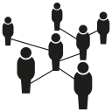
Guiding questions for the identification of mechanisms of indirect effects
Not all activities lead to effects that affect people indirectly and not all
mechanisms apply to all types of activities and outcomes. The following questions are
examples to guide the identification of relevant mechanisms for each specific project context.
Question | Mechanism
Could inviduals who are not part of our main target group have physical access to our provided service/products/knowledge? (→ How?) | Improved environment
Could people we address directly transfer information, knowledge, skills and/or goods or services aquired through our activities to others? (→How?) | Multiplication
Could a certain change (e.g. in behaviour/practice, norms and regulations) that we attribute to our work be copied and replicated by others? (→ How?) | Replication
Could a certain change (e.g. in behaviour/practice, norms and regulations) that we attribute to our work cause further positive effects on others? (→ How?) Could improvements to people’s life that we attribute to our work cause further positive effects on others? (→ How?) | Adoption, adaptation and transmission
Could other institutions extend their support as a result of our work? (How?) | Response
Could our target group derive additional positive or negative side effects from our activities (and/or their outcomes) in other spheres of their lives? | Competing needs/two birds with one stone
Could other groups of people be negatively affected by the improvements experienced by our target group? | Conflicts of interest
Back to “Identify mechanisms “
Tools

Slide 101

Fig. 1. Understanding scaling mechanisms

Slide 102

Suggestions for the identification of indirect and unintended effects
The following methods are useful techniques to identify indirect and unintended effects particularly at the stages of project planning and/or mid-term review:
Key informant interviews: Conducting in-depth interviews with knowledgeable people who have experience with comparable projects and ask them on potential positive and negative unintended effects and people indirectly affected by the specific project. This could be open questions, and/or guiding questions on mechanisms for unintended effects.
Outcome mapping/Outcome harvesting
Social network analysis
Ripple effects mapping
Develop a negative theory of change: This thought exercise follows the same process logic as the development of a “conventional” theory of change, but working upwards from the outputs, imagining potential risks and negative short- and long-term outcomes. These might be related to the actual project goal and beneficiary group, or follow a side-track to a different domain and group of people. For each step of the process of the negative theory of change, it is recommendable to assess the likelihood of occurring and what preventive measures could be put in place.
Six Hats Thinking Framework: This technique promotes holistic and lateral thinking. See more details in the tools section.
See more methods and approaches
in the “tools” section
See more detailed information on
these methods

Slide 103


Developing the MEL system
Define indicators
Once identified the mechanisms of change, including potential mechanisms for indirect effects, the next step is to identify appropriate methods for tracking the relevant effects and groups of people affected. In this step, it is important to think about who we want to reach most (i.e. especially vulnerable and marginalised groups), and how we can make these groups visible in our estimation.
The following questions can help at this stage:
“Who exactly will be affected through each identified mechanism?”
“How can we estimate the number of these people, ensuring gender disaggregated data?”*
“What indicators do we need for measuring our intended outputs, outcomes and impacts?”
“What additional indicators do we need to capture and potential unintended effects?”
How can we measure these indicators, and what resources are needed (time, skills, finance) for their measurement?
Note:
“Not everything that can be counted counts, and not everything that counts can be counted.”
(William Bruce Cameron)
Not all activities lead to indirect effects or affect people indirectly. A thorough analysis of potential mechanisms should be undertaken, and if the results show that certain outputs/outcomes don’t go along with any indirect effects, or that those effects can’t be reasonably tracked, proceed to the next one.
*Additional categories of social differentiation, such as gender, age or caste, might be of interest for disaggregation, depending on the project context. However, the possibility of generating disaggregated numbers depends on the strength of the methods used. The interest in disposing of information for further categories of disaggregation should be discussed at this stage and influence the decision on appropriate tracking methods.

Slide 104
Select methods and data collection plan
2.
3.
4.
5.
1.
Overview
As a next step, methods for data collection have to be identified. These methods should be both practically feasible and fulfil minimum standards to provide reliable results. The data collection on unintended effects should take place as aligned as possible with existing M&E procedures. The collected data might be useful for several purposes (e.g., a follow-up survey months after a communication event might track both the people deriving an indirect benefit of our work through knowledge transfer, and knowledge usage by our main target group).
The array of methods to gather the data of interest is broad and which method(s) to choose depends on several factors, such as the previously identified mechanisms for unintended effects, existing M&E procedures already in place, the level of detail required, the potential use of the data in other contexts or by other parties, and the availability of infrastructure and resources (skills, time, money).
When selecting one or more methods and a procedure for data collection, additional resources required have to be identified and allocated in the project’s time and budget plan. Even though it is desirable to select methods which are rigorous, inclusive and practically feasible, decisions usually need to be taken regarding the “trade-off” between these three dimensions (see figure on the right).
Example:
In Honduras, women were asked to share information about a new law that gives rural women access to credit with at least three others, and were followed-up on this practice afterwards. A differentiated follow-up regarding groups with whom the information was shared (family/collagues/friends) and their reactions allowed the project team to draw important conclusions for the targeting strategy of future activities.
Rigour
Inclusiveness
Feasibility
Fig. 2. Adapted from A. Van Hemelrijck and I. Guijt

Slide 105
Quantitative data collection methods
2.
3.
4.
5.
1.
Overview
Common options for data collection to track people indirectly affected and quantify unintended effects through previously identified mechanisms are:
Surveys with a sample of people we work with and/or project partners and allies via email/phone/in person (e.g. directly after their participation in events, several months later)
Bilateral interviews with a sample of people we work with and/or partners and allies (e.g. on knowledge transfer practice within institutions, employee numbers, etc.)
Get access to secondary data, e.g. demographic and sector statistics (such as average household sizes), business statistics (e.g. sales, average number of employees), public registries
Online tracking tools to gather information on readers, document downloads, cross-postings, newsletter opening- and forward rates etc.
See examples of different levels of rigour for estimation here.
For reach of mass media campaigns, the following tracking methods can be additionally relevant:
  Approximate headcount at events and public announcements, e.g. with people counter devices or extrapolating approximate amount of attendees by size of area (e.g. 5 sq ft per person standing)
  Tracking of media coverage (e.g. the frequency certain issues were reported in newspapers/radio/TV over a specific period of time) and using media customer research data to gather numbers of people reached
  Use customer statistics to estimate average amount of cars driving by an announcement, people using a mode of public transport where a poster is placed (…).
  Conduct pilot (e.g. count of people walking or driving by a banner and interview them on perception) & extrapolate
See Oxfam toolkit on digital and
social media MEL

Slide 106
Example:
Mapping example for media sensitisation
Adopta-
tion and
adaptation
Consumers
Multipli-
cation
Colleagues, editors
Journalists
Colleagues
Adoptation and
adaptation
Capacity building and media sensitisation on gender issues
Multiplication
Directors of media schools
NGO represen-tatives
Direct reach
Teachers
Indirect reach
Students
This example displays a map of how gender-related media sensitisation can lead to indirect reach through different mechanisms at output level (multiplication) and outcome level (adaptation and adoptation).
Overview of mechanisms
and examples

