Slide 1
How can INGOs turn Research into Impact?
Duncan Green
LSE and Oxfam
March 2021

Slide 2
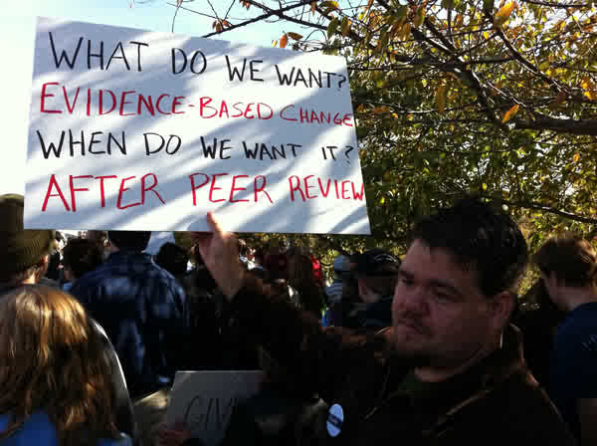

Slide 3
Yeah, right......

Slide 4
4 pillars of research for impact
Understand the system, including power analysis and change processes
Think about framing and timing
Think about Voice – who is doing/presenting the research?
Build relationships with targets and intermediaries before, during and after the research (then build them again)

Slide 5
Research the Problem and the System
Identify problems, causes & possible solutions
Decision making processes & key influencers
Power analysis to identify who has the power & capabilities to achieve change and who & what influences them
Wider system influences & contextual opportunities (eg critical junctures)

Slide 6
Notes:
Nb axes inverted, but it doesn’t matter

Slide 7
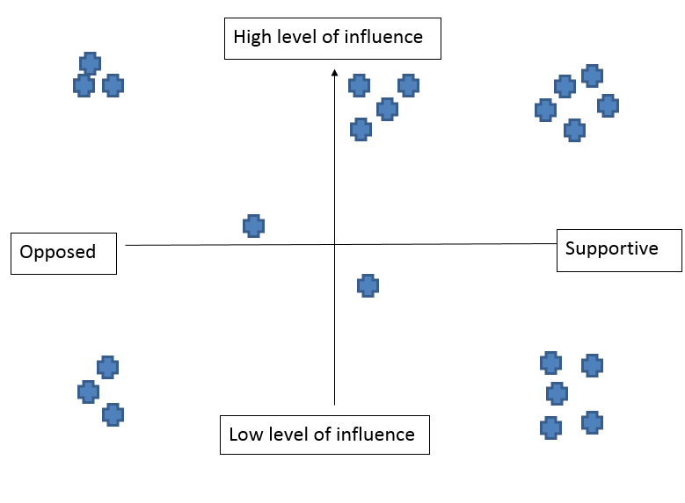
Power Mapping → Research Strategy
D
C
A
B

Slide 8
Some Possible Roles for Research
Group A: High Influence, High Support
Research as ammunition (eg killer facts); as conversation/convening
Group B: Low Influence, High Support
Research to build confidence/voice
Group C: High Influence, Low Support
What persuades? Messenger not message; Crisis response
Group D: High Influence, Opposed
‘Doubt is our product’; Delegitimise in eyes of others

Slide 9
Evidence needs to match the target
Target | Evidence they respond to best
Policymakers | Big ideas. Compelling stories. Positive visions.
Civil servants | Objective, rigorous, Credible methodology. Data. Technical details.
Corporate executives | Company-specific findings. Credible methodology.
Communities | Community-focused. Generated with their participation.
Activists, Public attitudes and beliefs | Human face to the story. Killer facts – easy to remember Clear impacts of policy
Media | Controversial, new. Human face to the story Killer facts with numbers.

Slide 10
Timing matters (and shapes research): The Policy Funnel
General Opinion
Public Debate
Policy Process
Final Decision
Concepts/agenda setting
Questions/Framing/instruments
Solutions/
Problems
$/ text
Room for manoeuvre falls, relative importance of internal players increases
What
Coalition? Power Analysis;
PDIA
Comparative; implementation gaps
Media and narrative, bearing witness;
Messengers not just message
Notes:
Adapted from work by Nick Mabey and Anita Neville at E3G

Slide 11
More on Timing (it really does matter)
Enter debates early
Climate change adaptation big numbers
Plan around the political timetable
Shocks = Crucial Windows of Opportunity (but a challenge for researchers)
Covid
Robin Hood Tax
Climate Change and shocks

Slide 12
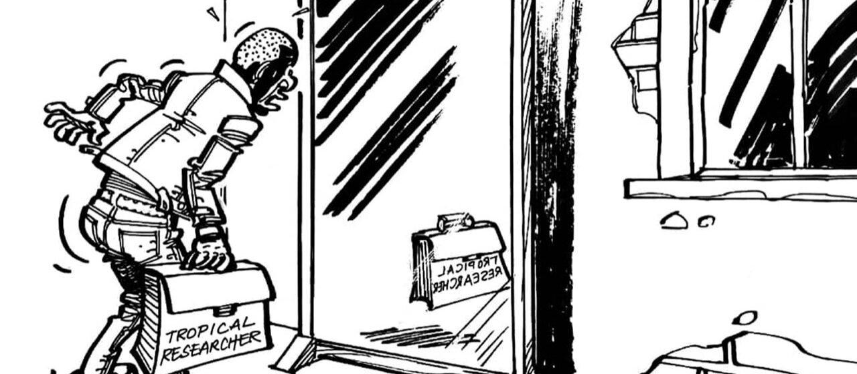
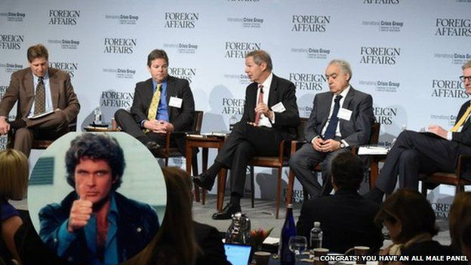
Who is doing/presenting the research?

Slide 13
How to engage targets?
BEFORE the research is published
Governance
Interviews and consultation
Review drafts
Be accessible, adapt to their timetables; build relationships before you need them
Who do they respect/listen to? Research partners and messengers as important as message
Closed v Open political systems
Did I mention relationships?

Slide 14
How to disseminate your findings?
Publish drafts and ask for comments
Ally with ‘knowledge intermediaries’ (e.g. thinktanks, sympathetic universities)
2 page (not 68 page) summaries, and op-eds, not long papers
Multi media (blogs, infographics, videos, twitter) all helps (but many senior decision makers still prefer newspapers or listen to peers)

Slide 15
Some Twitter negative feedback about NGO Research
Lack of rigour (‘marking our own homework’, ‘policy-based evidence making’)
Needs to decolonize authorship
Standardised diagnosis and Recommendations (usually process + £)
Inaccessible language (and getting worse!)
Denying complexity, trade-offs or difficulty: More aid will save the world
Too long!

Slide 16
So how does Oxfam do it? Source: Oxfam case study in 2018 book + world bank summary

Slide 17
Some Specialities
Framing and Branding – the Big New Idea (even if it isn’t that new!)
Prior relationships with decision makers (via CEO or advocacy team)
Messengers not just Message
Big foundational report + spin-offs
Killer Facts and Graphics
League tables and Indices

Slide 18
This week’s Killer Fact
‘in 2018, 245 million women and girls were subjected to sexual and/or physical violence by an intimate partner. That is more than all the people who contracted COVID-19 (confirmed cases) in the last 12 months.’

Slide 19
And an all-time Greatest Hit

Slide 20
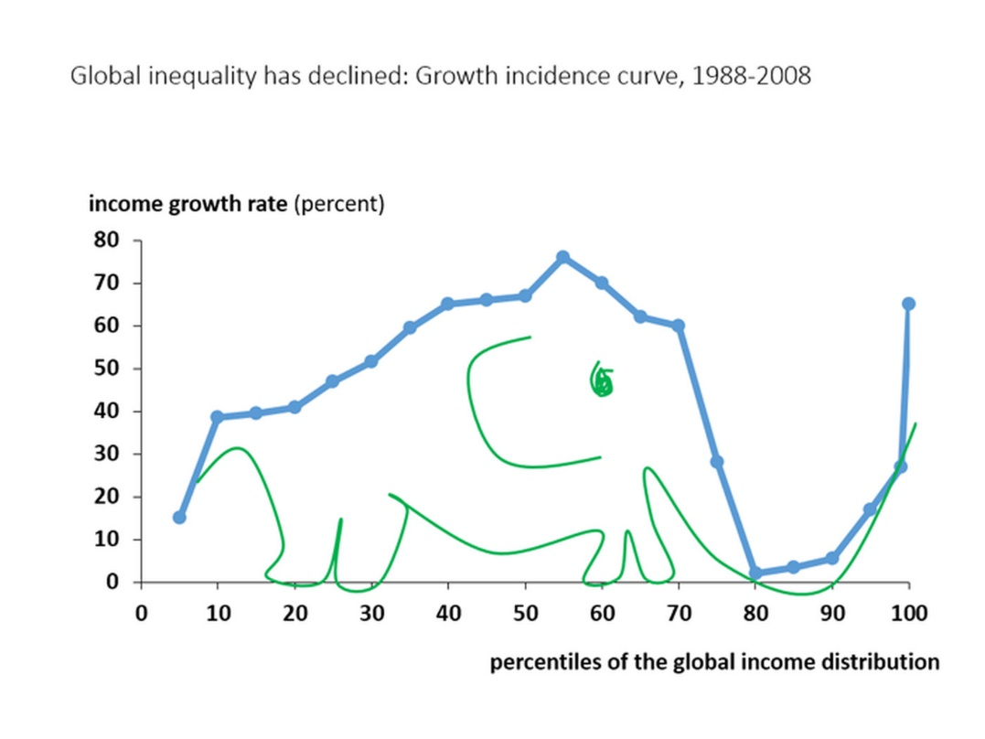
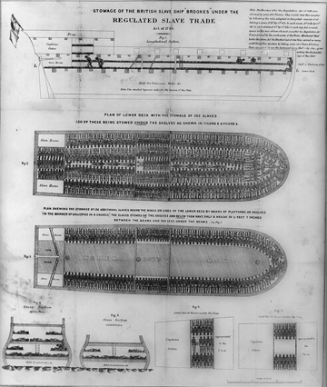
Killer Graphics also work

Slide 21
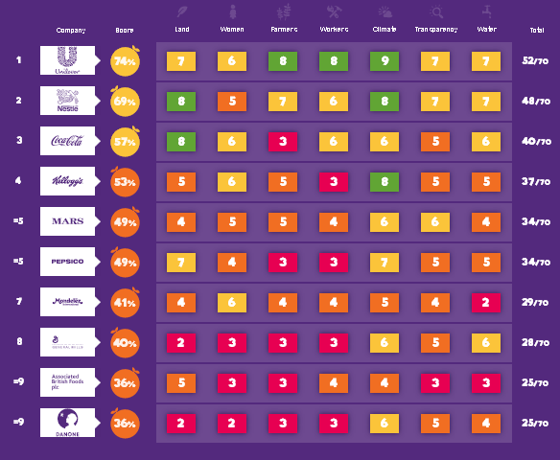
League Tables rattle cages

Slide 22
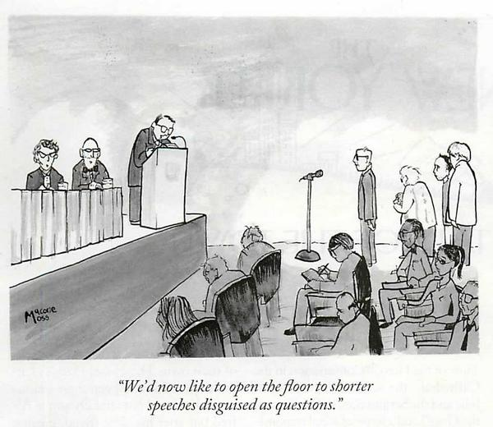
Thanks – any Questions?

